Slide 1

GENERAL ANATOMY
DPT
1ST SEMESTER
DR DANISH

Slide 2
Epicondyle
A projection above a condyle.
Serves as an attachment site for muscles and ligaments.
Example: Medial and lateral epicondyles of the humerus.

Slide 3
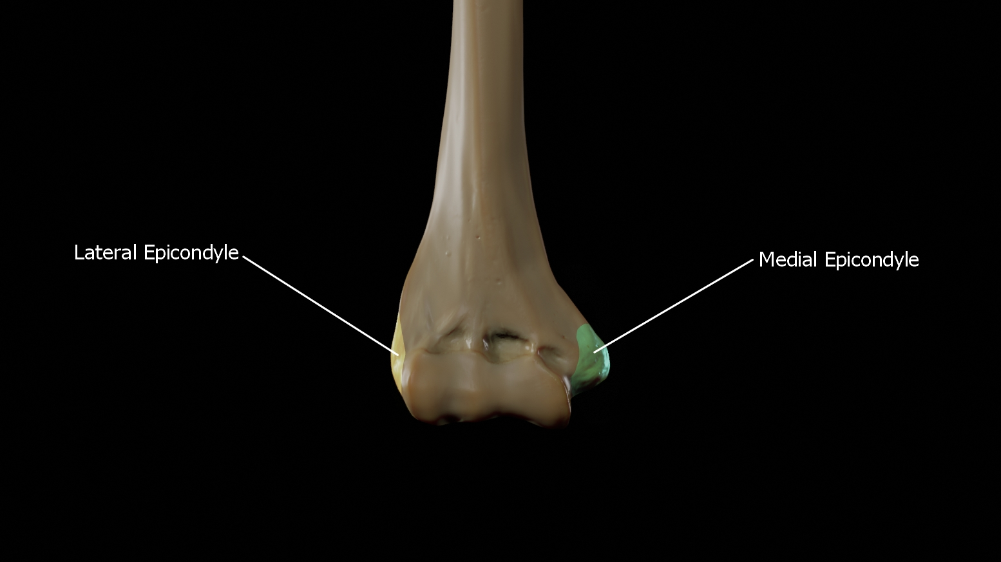

Slide 4
Spine
A sharp, slender projection of bone.
Usually serves as a muscle attachment point.
Example: Spine of scapula, anterior superior iliac spine.

Slide 5
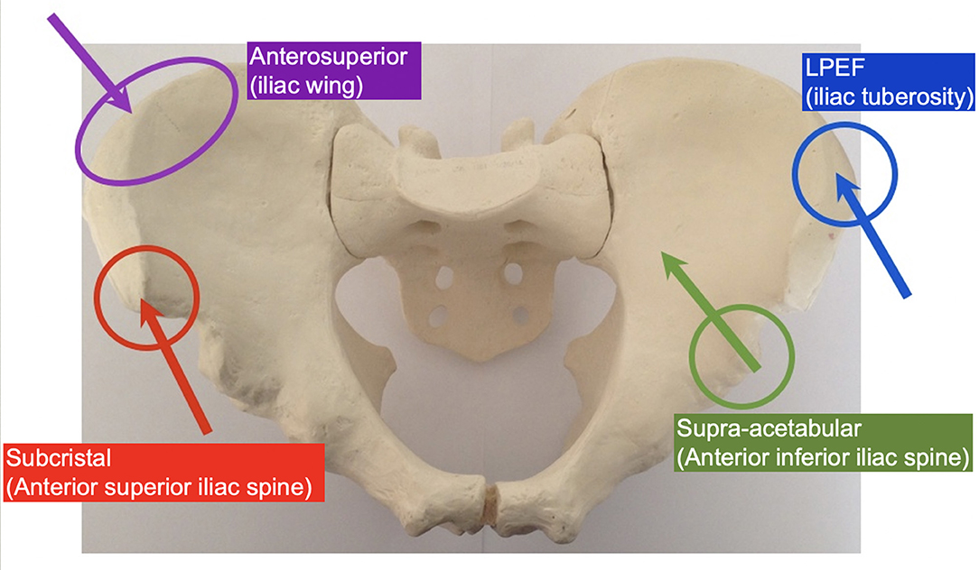
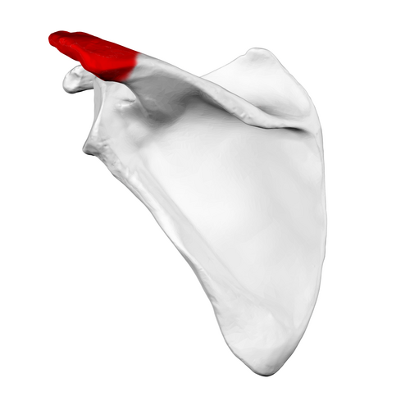

Slide 6
Hamulus
A hook-like process of bone.
Found in certain bones for ligament or tendon attachment.
Example: Pterygoid hamulus of sphenoid bone.

Slide 7
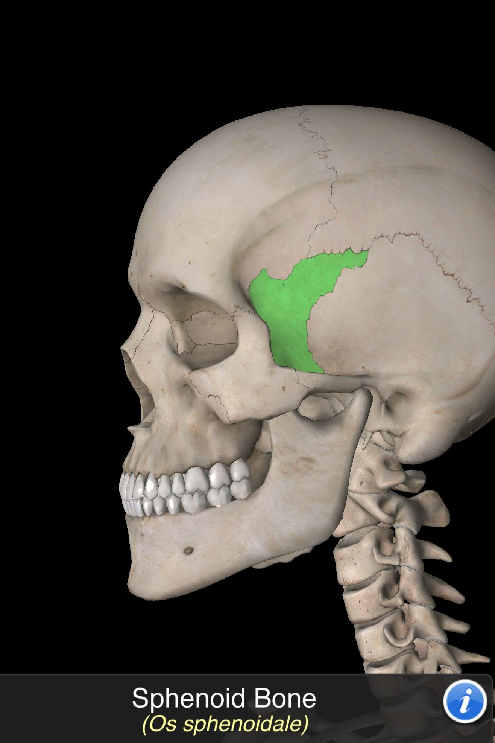

Slide 8
Ridge
A linear elevation on a bone surface.
Often provides attachment for muscles.
Example: Supracondylar ridge of humerus.

Slide 9
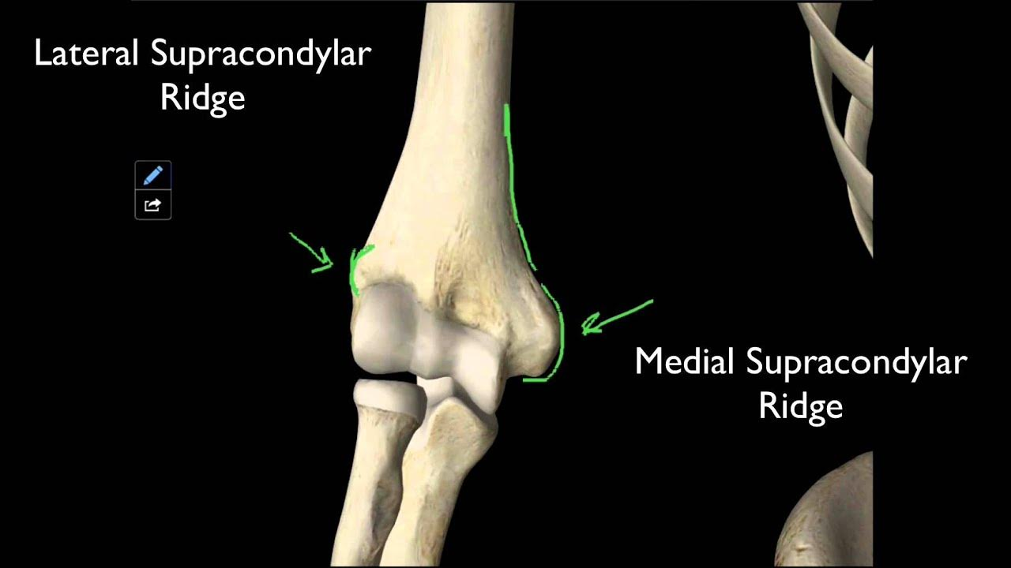

Slide 10
Crest
A prominent, narrow ridge of bone.
Serves as muscle or ligament attachment site.
Example:intertrochantercic crest of femur

Slide 11
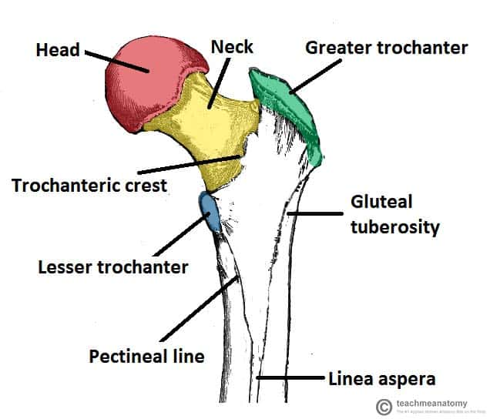

Slide 12
Line
A slight, low ridge on a bone surface.
Less prominent than a crest.
Example: Linea aspera of femur.

Slide 13
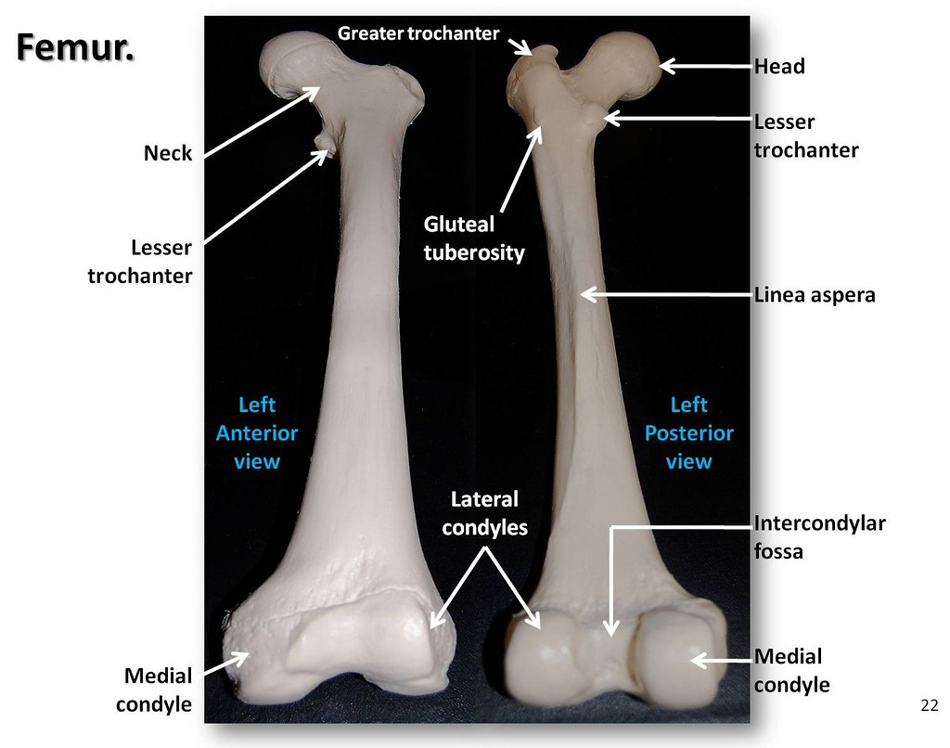

Slide 14
Fovea
A small pit or depression on a bone surface.
May serve as an attachment site or for articulation.
Example: Fovea capitis on the head of femur.

Slide 15
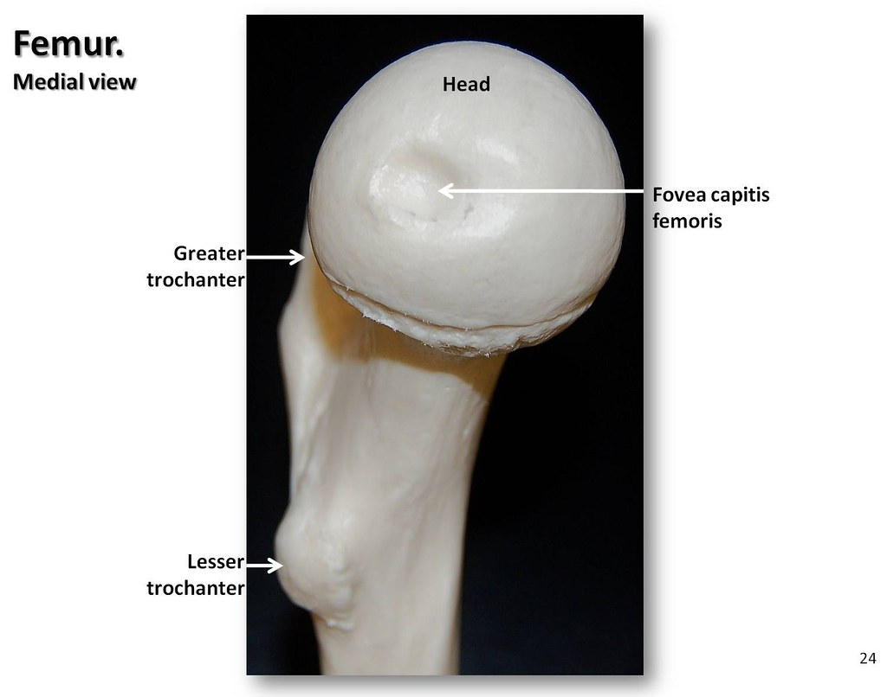

Slide 16
Notch
An indentation or deep cut on the edge of a bone.
Often allows passage of nerves or vessels.
Example:suprascapular notch of scapula on posterior border

Slide 17
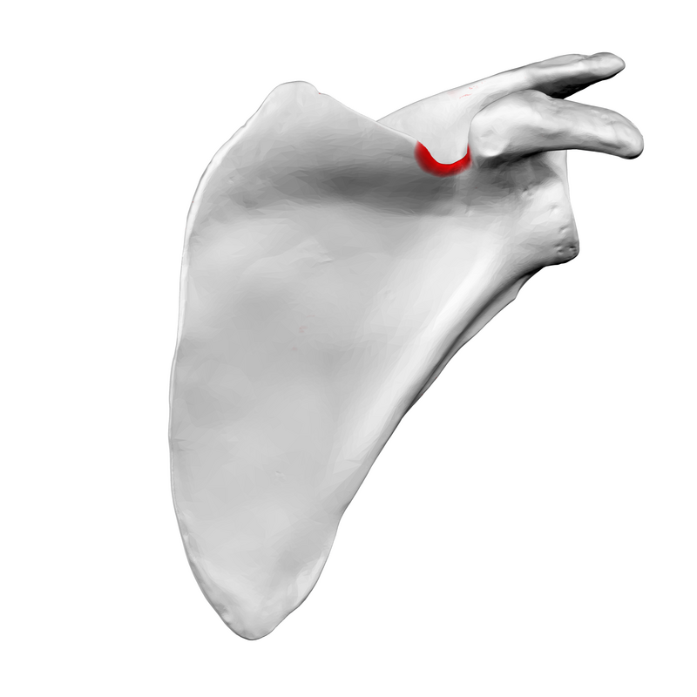

Slide 18


Slide 19


