Slide 1
Statistics
DPT
1ST SEMESTER
AWAIS HAMZA

Slide 2
Population and Sample
Population:
It includes all the elements from the data set and measurable characteristics of the population such as mean and standard deviation are known as a parameter. For example, All people living in India indicates the population of India.

Slide 3
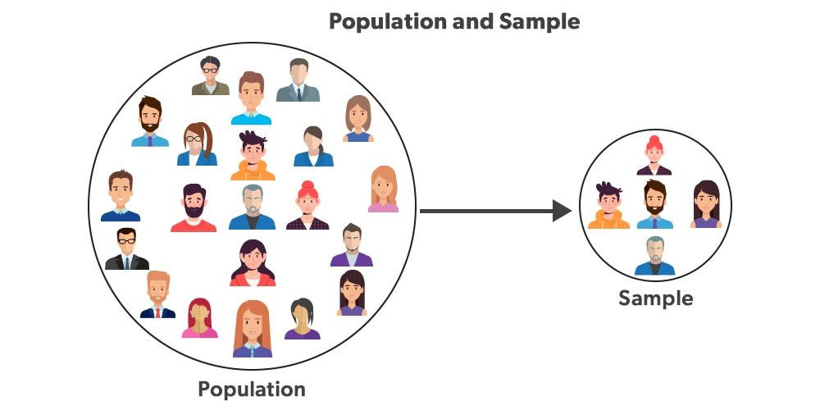
Population and Sample

Slide 4
Population
There are different types of population. They are:
Finite Population
Infinite Population
Existent Population
Hypothetical Population

Slide 5
Finite Population
The finite population is also known as a countable population in which the population can be counted.
In other words, it is defined as the population of all the individuals or objects that are finite.
For statistical analysis, the finite population is more advantageous than the infinite population. Examples of finite populations are employees of a company, potential consumer in a market.

Slide 6
Infinite Population
The infinite population is also known as an uncountable population in which the counting of units in the population is not possible.
Example of an infinite population is the number of germs in the patient’s body is uncountable.

Slide 7
Existent Population
The existing population is defined as the population of concrete individuals. In other words, the population whose unit is available in solid form is known as existent population.
Examples are books, students etc.

Slide 8
Hypothetical Population
The population in which whose unit is not available in solid form is known as the hypothetical population.
A population consists of sets of observations, objects etc that are all something in common.
In some situations, the populations are only hypothetical.
Examples are an outcome of rolling the dice, the outcome of tossing a coin.

Slide 9
Sample
It includes one or more observations that are drawn from the population and the measurable characteristic of a sample is a statistic. Sampling is the process of selecting the sample from the population. For example, some people living in India is the sample of the population.
Basically, there are two types of sampling. They are:
Probability sampling
Non-probability sampling

Slide 10
Probability Sampling
In probability sampling, the population units cannot be selected at the discretion of the researcher. This can be dealt with following certain procedures which will ensure that every unit of the population consists of one fixed probability being included in the sample. Such a method is also called random sampling.

Slide 11
Probability Sampling
Some of the techniques used for probability sampling are:
Simple random sampling
Cluster sampling
Stratified Sampling
Disproportionate sampling
Proportionate sampling
Optimum allocation stratified sampling
Multi-stage sampling

Slide 12
Non Probability Sampling
In non-probability sampling, the population units can be selected at the discretion of the researcher. Those samples will use the human judgements for selecting units and has no theoretical basis for estimating the characteristics of the population. Some of the techniques used for non-probability sampling are
Quota sampling
Judgement sampling
Purposive sampling

Slide 13
Population and Sample Examples
All the people who have the ID proofs is the population and a group of people who only have voter id with them is the sample.
All the students in the class are population whereas the top 10 students in the class are the sample.
All the members of the parliament is population and the female candidates present there is the sample.

Slide 14
Feature | Population | Sample
Definition | The entire set of individuals, items, or data that you are interested in studying. | A subset of the population selected for analysis.
Size | Usually very large or theoretically infinite. | Smaller and manageable portion of the population.
Representation | Contains all possible data points. | Represents the population but may have some variability.
Purpose | To understand characteristics of the whole group. | To make inferences or estimates about the population.
Data Notation | Usually denoted by parameters (e.g., μ for mean, σ for standard deviation). | Usually denoted by statistics (e.g., x̄ for mean, s for standard deviation).
Example | All students in a university. | 200 students randomly selected from that university.

Slide 15
Collecting Data From the Population and Sample
When to use a Population:
Populations are used when your research question requires it, or when you have access to data from every member of the population. Usually, it is only straightforward to collect data from a whole population when it is small, accessible, and cooperative.

Slide 16
When to use a Population
Example:
A marketing manager at a small local bakery wants to understand customer preferences.
They collect data on every customer’s bread purchase over a month.
Since the customer base is limited and accessible, they analyze the entire population to identify trends.

Slide 17
When to use a Sample
When your population is large in size, geographically dispersed, or difficult to contact, it’s necessary to use a sample. With statistical analysis, you can use sample data to make estimates or test hypotheses about population data.
Example:
You're researching smartphone usage among teenagers in a city.
The population includes all teenagers aged 13–18, which could be tens of thousands.
You select a random sample of 500 teens from different schools.
This sample participates in surveys to provide insights into broader usage patterns.

Slide 18
Descriptive vs Inferential Statistics
Descriptive Statistics
Definition: Methods of organizing, summarizing, and presenting data so that it is understandable.
Purpose: To describe the characteristics of a dataset without making predictions or conclusions about a larger population.

Slide 19
Descriptive Statistics
Tools & Techniques:
  Measures of Central Tendency: Mean, Median, Mode.
  Measures of Dispersion: Range, Variance, Standard Deviation.
  Charts & Graphs: Histograms, Pie charts, Bar graphs.
Example:
  Average marks of 100 students in a class.
  Percentage of males and females in a survey group.
Key point: Descriptive statistics summarizes the data you have, no assumptions beyond your dataset.

Slide 20
Inferential Statistics
Definition: Methods used to make predictions or generalizations about a population based on a sample.
Purpose: To draw conclusions, test hypotheses, or estimate population parameters.
Tools & Techniques:
Hypothesis testing (t-test, chi-square test)
Confidence intervals
Regression analysis

Slide 21
Inferential Statistics
Example:
  Estimating the average height of all adults in a city based on a sample of 200 adults.
  Predicting election results based on polling data.
Key point: Inferential statistics goes beyond the data you have and makes predictions about a larger group.

Slide 22
Discrete vs Continuous Variables
Discrete Variables
Definition: Variables that take only specific, separate values (usually counted).
Characteristics:
  Cannot take fractional values,Often counted, not measured.
Examples:
  Number of students in a class (1, 2, 3…), Number of cars in a parking lot, Number of patients visiting a clinic
Visualization: Bar charts, Pie charts

Slide 23
Continuous Variables
Definition: Variables that can take any value within a range (measured, not counted).
Characteristics:
Can take fractional values., Often measured with instruments.
Examples:
Height of students (160.5 cm, 161.2 cm)
Weight of patients (65.3 kg)
Temperature of a room
Visualization: Histograms, Line graphs

Slide 24
Errors of Measurement
Definition
In statistics, an error of measurement is the difference between the observed (measured) value and the true value of a variable:
Measurement Error=Observed Value -True Value
Observed Value (OV): The value obtained from measurement.
True Value (TV): The exact, actual value.
No measurement is perfectly exact; all data contain some degree of error. Understanding errors is crucial for data reliability, accuracy, and validity in statistical analysis.

Slide 25
Types of Measurement Errors
Systematic Error (Bias)
Definition: A consistent, repeatable error that distorts measurements in the same direction.
Impact: Reduces accuracy (measurements deviate from the true value).
Causes:
  Faulty or uncalibrated instruments.
  Observer bias (subjective reading or recording).
  Environmental conditions (temperature, humidity, etc.).

Slide 26
Systematic Error (Bias)
Examples:
A weighing scale that reads 2 kg higher for all measurements.
A thermometer that always reads 0.5°C too low.
Detection & Correction:
Calibration of instruments.
Standardized measurement procedures.
Training to reduce observer bias.

Slide 27
Random Error (Noise)
Definition: Unpredictable variations in measurement due to uncontrollable small factors.
Impact: Reduces precision (repeatability) but not accuracy if averaged over many measurements.
Causes:
  Environmental fluctuations (room temperature, vibration).Human factors (reaction time, slight positioning differences).Instrument sensitivity or limitations.
Examples:
  Slight differences in repeated blood pressure readings, Minor variations in repeated weighing of an object.
Reduction Strategies:
  Take multiple measurements and calculate the mean,Use highly precise instrument,.Maintain controlled environment.

Slide 28
Gross Error
Definition: Large, avoidable mistakes due to carelessness, misreading, or procedural errors.
Impact: Strongly affects both accuracy and precision. Produces outliers.
Causes:
Human mistakes (recording wrong units, misreading scale).
Procedural errors (wrong method, formula misapplication).

Slide 29
Gross Error
Examples:
Recording 100 kg instead of 10 kg.
Using pounds but recording as kilograms.
Prevention:
Proper training and care in measurement.
Double-checking recorded data.
Repeating suspicious measurements.

Slide 30
Additional Concepts in Measurement Errors
Concept | Meaning | Error Type Affected
Accuracy | Closeness of measurements to the true value | Systematic error
Precision | Repeatability/consistency of measurements | Random error

Slide 31


Slide 32


