Slide 1

Role of Leadership in Health Management

Slide 2
Outlines
Define leadership
Importance of leadership
Leadership in Health care management
Characteristics effective leadership

Slide 3
Leadership Styles
Decision Making in High Stress Environment
Building a Collaborating Environment
Case Study

Slide 4
DEFINE
''A leader is the one in the charge ,the person who convinces other people to follow'''.
''Leadership is the art or process of Influencing people so that they will strive willingly towards the achievemenet of specific goal''.
Leaders have the ability to impact the thoughts ,feellings,and action of others.

Slide 5
Importance of Leadership
Leadership is important In workplace because it helps organization to achieve the goal.
Provide direction
Inspire others
Encourage collaboration

Slide 6
Leadership in Health Care Management
Health care organization are large ,complex and highly logistical facilities. They are composed large staff.
Leadership is necessory in health care management to manage
Large staff
Budgets
Conflicts
Risks

Slide 7
Leadership is critical in healthcare because it improve patient care .
Effective leadership ensures that patient receive safe, high quality and compassionate care.
Healthcare leader are not responsible for directly administering medical care to patient .

Slide 8
Responsibilities of Leadership
Their role includes contingency planning and rapid decision-making under pressure.
Strategic Planning:
Workflow Optimization:
Performance Monitoring:
Crisis Management:

Slide 9
Challenges Faced by Health Leaders
Staff Shortages:
Managing schedules and maintaining quality care with limited staff can be challenging.
2) Technological Complexity:
With advancements in surgical techniques and equipment, leaders must ensure proper training and integration.

Slide 10
Challenges:
3) Patient Demands:
Balancing patient satisfaction with operational constraints requires skilled negotiation and planning.
4) Interpersonal Conflicts:
Resolving disputes among team members or addressing performance issues requires diplomacy and fairness

Slide 11
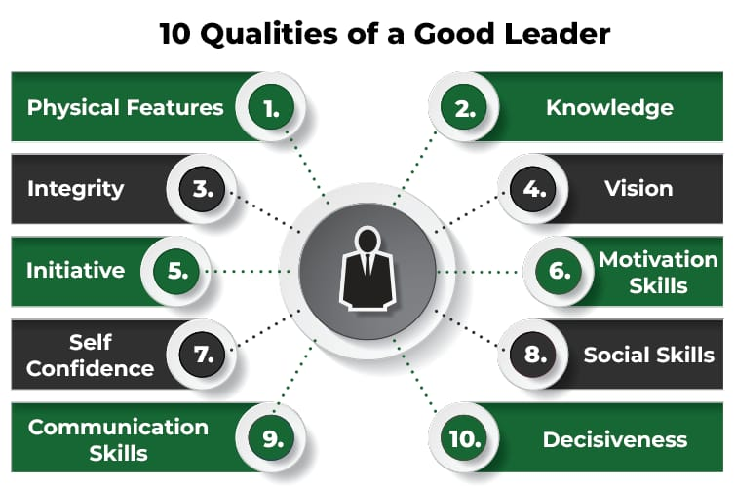
Characteristics of Effective Leadership

Slide 12
Characteristics:
Self – awareness
Understanding your strengths and weaknesses, and how your actions affect others .
Resilience
Being able to handle difficult situations and creating new processes or hiring new people when needed.

Slide 13
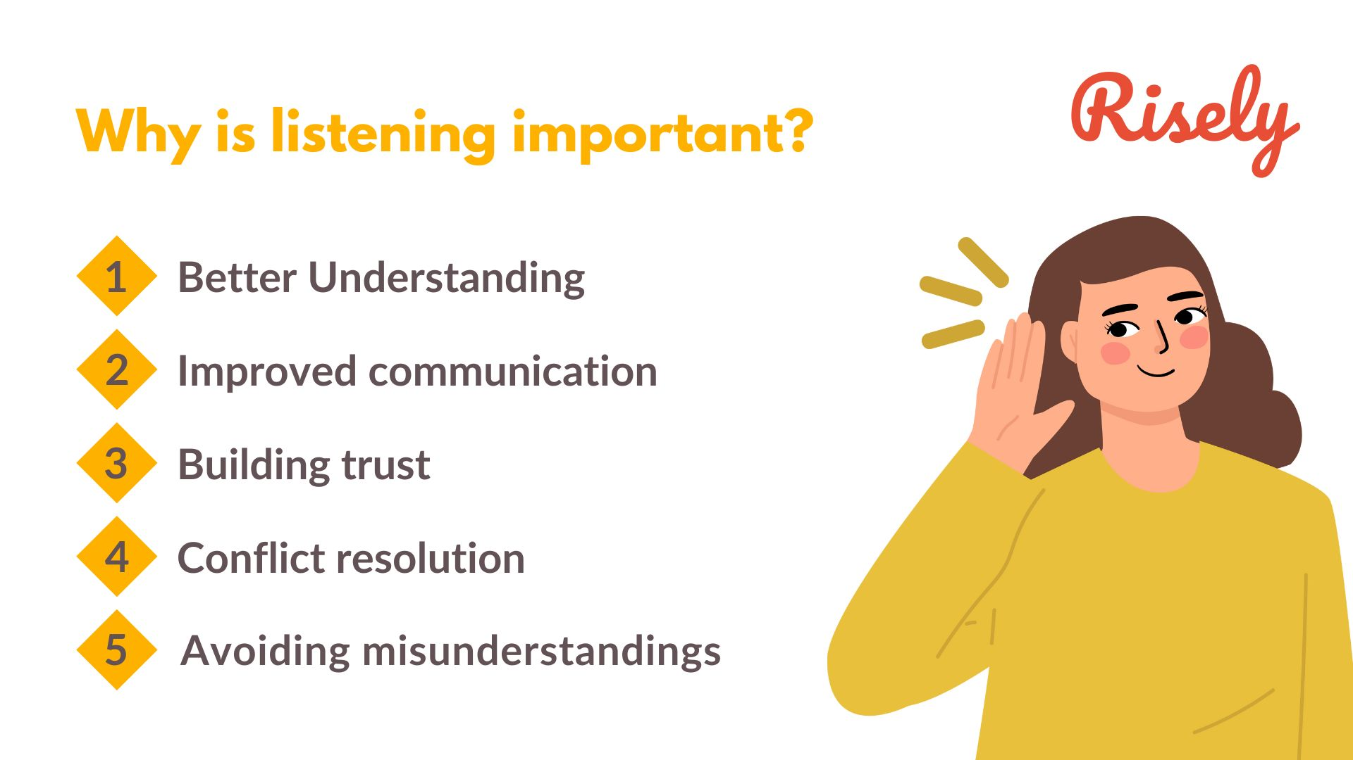
Characteristics:
Active listening
Listening to what your
employees say, without
interrupting or judging them.

Slide 14

Characteristics:
Confidence
Confident leaders are able
To think quickly under pressure
And make decision when needed.

Slide 15
Characteristics:
Innovation
Considering current trends when formulating strategies for the future, and reinforcing change that are needed.
Motivating
Empowring your team to perform to the best of the ability.

Slide 16
Characteristics:
Problem Solver
Being able to think critically and strategically to arrive a reasonable conclusion.
Visionary
An effective leader has a clear, compelling vision of the future . They can articulate this vision and inspire others to work towards it.

Slide 17
Leadership Style
A leadership style is a leader's method of providing direction, implementing plans and motivating people.
Most common leadership style are given below .
Autocratic leadership
2) Democratic leadership
3) Laissez-Faire leadership

Slide 18
4) Transformational Leadership
5) Transactional Leadership
6) Situational Leadership
Detail of all these leadership style are given in next slides.

Slide 19
Autocratic Leadership
. Leader makes decision unilaterally, without consulting the team.
''Do as I Say''
. High control of leader
. No team participation
. Best for quick decision making

Slide 20
2) Democratic leadership
The leader involve team member in decision- making.
Balanced participation
Increased staff productivity
Diverse ideas
Innovation in workplace

Slide 21
3) Laissez-Faire Leadership
Leader provide minimal supervision and allow the team members to make decision.
Effective with highly skilled, self motivated team.
Low control of leader
Employee can make decision without waiting of approval

Slide 22
4) Transactional Leadership
. Leadership style that use reward and punishment to motivate follower.
. Moderate control
. Effective for short term

Slide 23
5) Transformational Leadership
.Leader focus on motivating and encourage
.Aim of this style to inspire the people and to make positive change in people , teams and organization.
Suitable for innovative and long term goals

Slide 24
6) Situational leadership
. Adapt leadership style based on the situation.
. It can be effective in emergency situation
. Leader can adopt any style to achieve specific goal of the organization.

Slide 25
Role of leadership in Conflict Resolution
Leadership play a critical role in conflict resolution, particularly in situations where tenshion may arise due to different opinion , interest or goal.
A strong leader can not only mediate disputes but also help to prevent conflicts from escalating and guide the team toward a solution that benefits everyone involved.
Here are the key ways in which leadership impact conflict resolution.

Slide 26
Creating a positive and open Environment
Listening and Understanding different perspective
Remaining Neutral
Defusing Tension
Guiding towards a Win-Win Solution
Encourage Responsibility

Slide 27
Setting Clear Expectations and Boundaries
Building a collaboration
Promoting team unity after Conflicts
Effective leader not only address conflicts as they arise but also work to prevent conflicts by creating a environment of respect and collaboration.

Slide 28
Role of Leadership in Building a Collaborating Environment
Leadership plays a central role in building and fostering a collaborative environment within teams and organizations.
Collaboration leads to greater innovation, productivity, and problem-solving, and it’s up to leaders to create an atmosphere where individuals feel valued, motivated, and empowered to work together.
Here are the key ways in which leadership contributes to building a collaborative environment:

Slide 29
Setting a Clear Vision and Purpose
Encouraging Open Communication
Providing Opportunities for Collaboration
Empowering Team Members
Supporting Conflict Resolution
Encouraging Innovation and Creativity

Slide 30


