Slide 1
Operation Theatre Lighting
ADNAN RAMZAN
Doctors Institute of Medical & Emerging Science

Slide 2
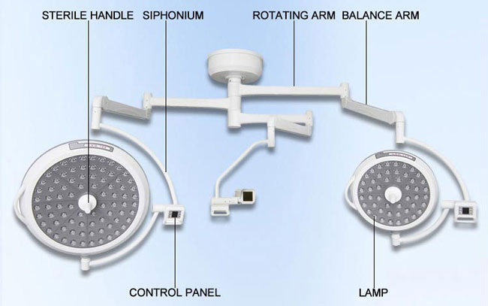

Slide 3
Importance of Lighting in the Operating Theatre
The human eye is best adapted for vision in natural light.
Lighting systems in operation theatres aim to emulate natural lighting.
Proper lighting prevents glare, shadows, and visual stress.
Helps surgeons perform accurately and safely.
Poor lighting can lead to mistakes and longer procedures.

Slide 4
Lighting Selection Team
Surgeons – Need specific illumination based on their specialty.
Nurses & OT Assistants – Focus on maneuverability and ease of use.
Biomedical Engineers – Evaluate technical specifications and power systems.
Purchase & Finance – Manage costs, taxes, and negotiations.
Notes:
Movement of OT light with care and skill(Meneuverability)

Slide 5
Basic Objectives for Lighting Selection
Adjustability: Lighting should adapt to different procedures.
Brightness: Must illuminate the surgical area effectively.
Control: Lighting design should allow flexibility and integration into the theatre environment.

Slide 6
Surgical Lighting Configurations
Ceiling-mounted lights: Fixed to the ceiling, provide stable illumination.
Wall-mounted lights: Attached to walls, used for examinations.
Floor-standing lights: Movable on wheels for flexibility between rooms.

Slide 7
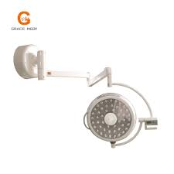
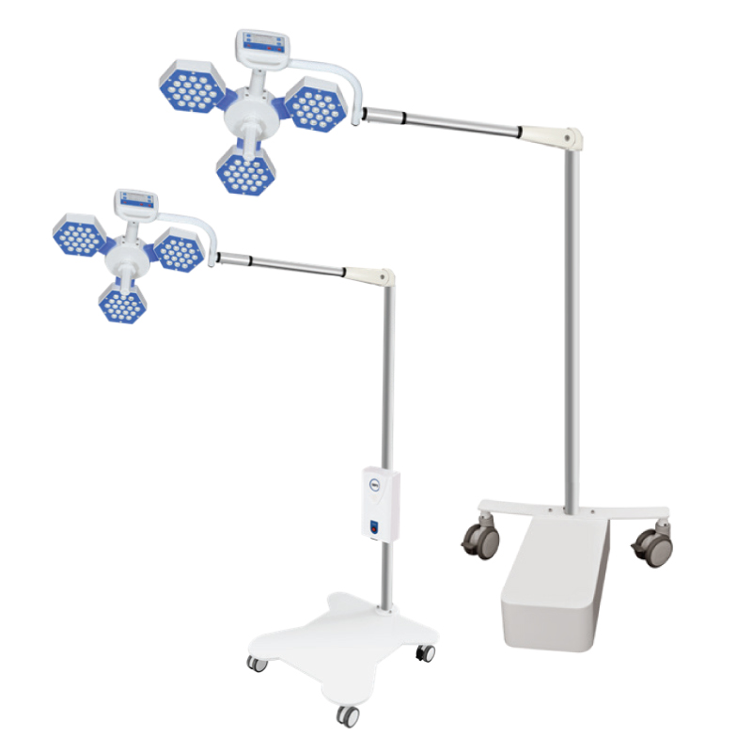

Slide 8
Lamp Technologies Used
Incandescent Lamps: Traditional type using halogen or tungsten.
Gas Discharge Lamps: Use xenon or quartz for bright illumination.
LED Lamps: Modern choice, energy-efficient, longer life, adjustable color output.

Slide 9
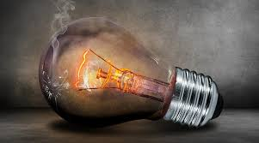
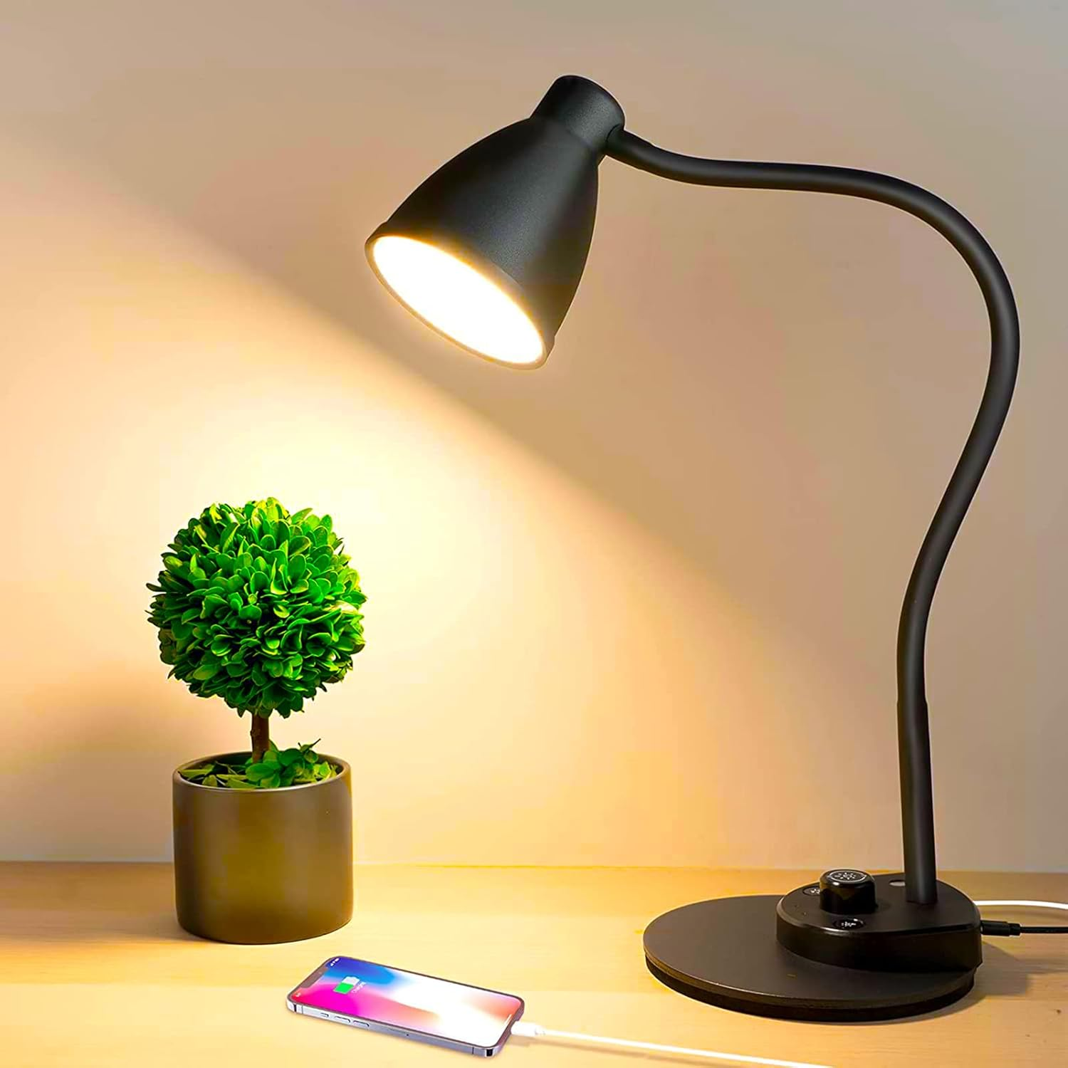

Slide 10
Lighting Technical Specifications
Lux (lx): Measures visible light intensity.
Central Illuminance (Ec): Light intensity at 1m distance from the source.
Light Field Centre: Point of maximum illumination.
Depth of Illumination: Range over which light intensity remains adequate.

Slide 11
Norms and Requirements for Surgical Light
Homogenous light: Uniform illumination without shadows.
Lux range: 160,000 to 40,000 lux.
Colour Rendition Index (Ra): Between 85 and 100 for true color distinction.
Backup: Should restore 50% brightness within 5 seconds after power failure.
Notes:
Colour Rendition Index (CRI) or Ra means the average ability of a light source to accurately show the colors of objects compared to natural sunlight

Slide 12
Additional Simplified Points
Lights should not produce heat that affects the surgical area.
Adjustable color temperature helps view tissues more clearly.
Modern lights often have touchless control to maintain sterility.
Regular maintenance ensures consistent performance.

Slide 13


