Slide 1
Operation Theater Lighting Design
FSC(OT)
ADNAN RAMZAN

Slide 2
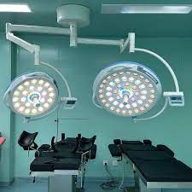

Slide 3
Lighting Design Basics
Operating theater lights are designed to give bright, shadow-free illumination during surgery.
Lights can be single or multiple head units – ceiling, wall, or floor mounted.
Main and satellite lights are used together to reduce shadows on the surgical site.
Single lamps alone may not give enough light for surgical procedures.

Slide 4
Radiant Energy and Heat
Radiant energy includes visible light and heat emitted from the light source.
Excess heat can disturb laminar airflow and make the environment uncomfortable.
Halogen lights waste more energy as heat, making them less efficient.
Modern systems use designs that reduce heat effects to maintain a sterile, cool environment.

Slide 5
Radiant energy means the energy that comes from a light source, like a bulb.
This energy has two main parts:
Visible light — the light we can see.
Heat — the warmth that comes from the light.
In simple words:
Radiant energy is the light and heat that a lamp gives off when it is turned on.

Slide 6
Advantages of LED Lights
LEDs do not produce much heat and are more energy efficient than halogen lights.
They have a long lifespan (up to 60,000 hours).
LED lights give clear, consistent illumination and reduce glare.
They are small, durable, and cost-effective over time.

Slide 7
HID (High Intensity Discharge) Lighting
Uses electrical discharge through gas to produce intense light.
Commonly used for strong illumination needs.
Provides bright and clear light suitable for certain medical uses.
Notes:
High-intensity discharge (HID) lighting is a type of electric-discharge lamp that produces a very bright light from an arc between tungsten electrodes in a gas and metal salt-filled arc tube. Common types include mercury vapor, metal halide, and high-pressure sodium lamps, and they are used for applications like street lighting, stadiums, and large indoor spaces due to their high lumen output and long lifespan.

Slide 8
Requirements for Surgical Lights
Brightness should not exceed 160,000 Lux.
Light head diameter: 400–700 mm; average system weight: 45 kg.
Light lifespan: 40,000–60,000 hours of use.
Must provide uniform, shadow-free, and cool light for long surgeries.

Slide 9
Incandescent and Halogen Lighting
Halogen lamps were traditionally used in surgery but have short life spans (1,000–3,000 hours).
They emit more heat and can cause discomfort and faster burnout.
Halogen lamps give warm yellowish light with lower color temperature (~3000K).
Touching halogen bulbs with fingers shortens their lifespan.

Slide 10
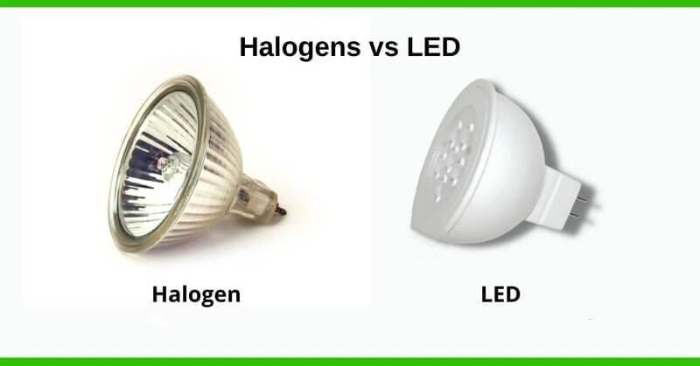

Slide 11
Comparison of Light Types
Incandescent/Halogen: Short life, high heat, low efficiency.
LED: Long life, cool, energy efficient, low maintenance.
HID: Very bright, used for specific applications.

Slide 12
Conclusion
LEDs are the most preferred lighting for modern operating theaters.
They ensure better visibility, less heat, and lower long-term cost.
Proper lighting design improves surgical precision and safety.

Slide 13


