Slide 1
Diseases Related to Skin
Bsc RIT
AWAIS HAMZA

Slide 2
Viral infections
Human papilloma virus (HPV)
This causes warts or veruccas that are spread by direct
contact, e.g. from another lesion or another infected individual.
There is proliferation of the epidermis and development
of a small firm growth, which is nearly always benign.
Common sites are the hands, the face and solesof the feet.

Slide 3
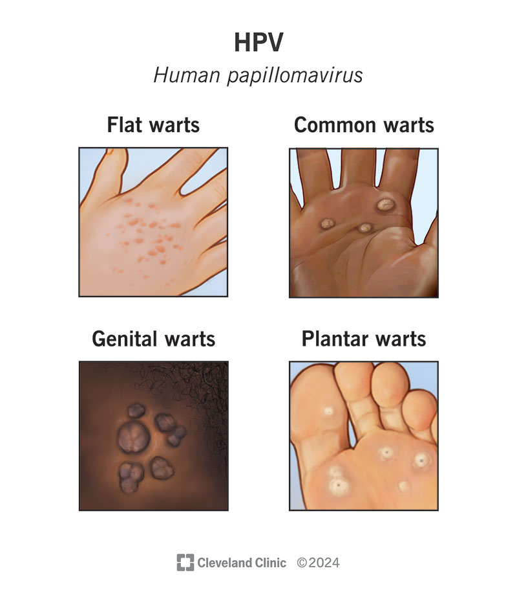

Slide 4
Herpes viruses
Rashes seen in chickenpox and shingles are
caused by the herpes zoster virus. Other herpes viruses
cause cold sores (HSV1) and genital herpes

Slide 5
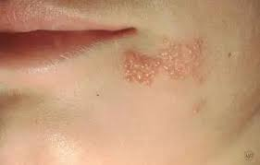

Slide 6
Bacterial infections
Impetigo
This is a highly infectious condition commonly caused by Staphylococcus aureus. Superficial pustules develop, usually round the nose and mouth.
It is spread by direct contact and affects mainly children and immunosuppressed
individuals.
When caused by Streptococcus pyogenes (group A β-haemolytic streptococcus) the infection may be complicated by an immune reaction causingglomerulonephritis a few weeks later

Slide 7
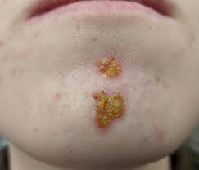
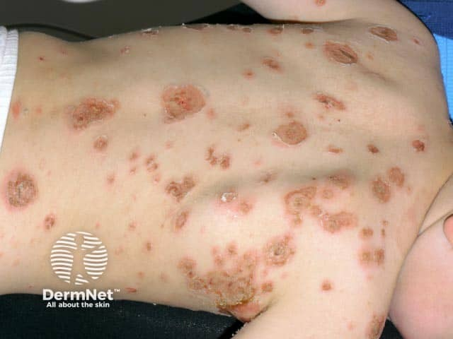

Slide 8
Cellulitis
This is a spreading infection caused by some anaerobic bacteria including Streptococcus pyogenes and Clostridium perfringens that enter through a break in the skin.
Their spread is facilitated by the formation of enzymes that break down the connective tissue that normally isolates an area of inflammation.
If untreated, the bacteria may enter the blood causing septicaemia.
In severe cases necrotising fasciitis may occur. There is rapid and progressive necrosis of subcutaneous tissue that usually includes the fascia in the affected area.
Multiple organ failure is common and mortality is high.

Slide 9
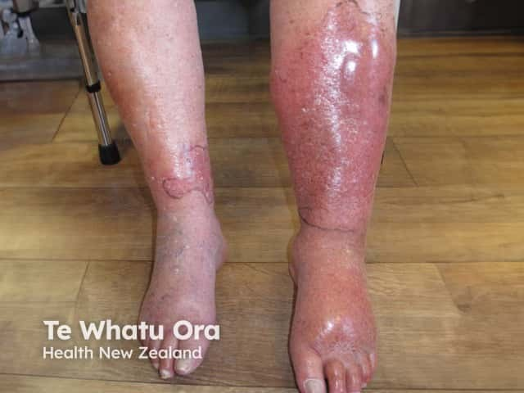

Slide 10
Fungal infections (mycoses)
Ringworm and tinea pedis
These are superficial skin infections. In ringworm there is an outward spreading ring of inflammation.
It most commonly affects the scalp, feet and groin and is easily spread
to others.
Tinea pedis (athlete’s foot) affects the skin between the toes.
Both infections are spread by direct contact.

Slide 11
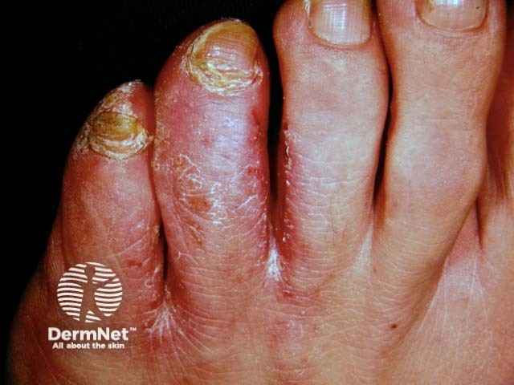
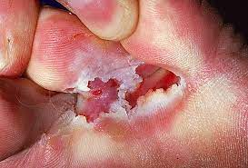
Fungal infections (mycoses)

Slide 12
Non-infective inflammatory conditions
Dermatitis (eczema)
Dermatitis is a common inflammatory skin condition that may be either acute or chronic. In acute dermatitis there is redness, swelling and exudation of serous fluid usually accompanied by pruritus (itching). This is often followed by crusting and scaling. If the condition becomes chronic,
the skin thickens and may become leathery due to longterm scratching, which may cause infection.

Slide 13
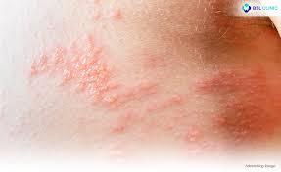
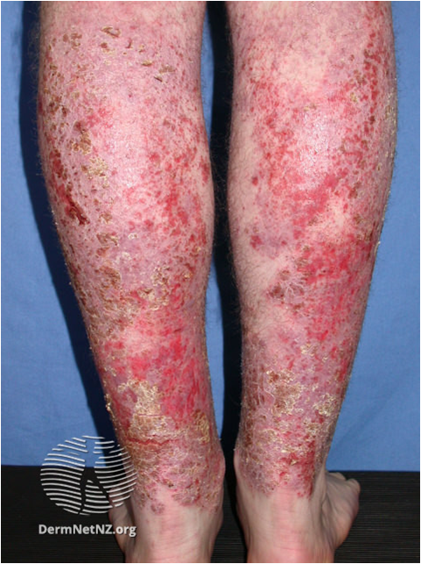
Dermatitis (eczema)

Slide 14
Dermatitis (eczema)
Atopic dermatitis is associated with allergy and commonly affects atopic individuals, i.e. those prone to hypersensitivity disorders Children, who may also suffer from hay fever or asthmaare often affected.
Contact dermatitis may be caused by direct contact with irritants, e.g. cosmetics, soap, detergent, strong acids or alkalis, industrial chemicals or a hypersensitivity reactionto, e.g., latex, nickel, dyes and other chemicals.

Slide 15
Psoriasis
A common genetically determined skin condition. Shows flare-ups (exacerbations) and periods of remission of different lengths. Basal epidermal cells multiply faster and move upward quickly, causing incomplete maturation of the top skin layers.
Appears as red, scaly plaques with a silvery surface.Bleeding may occur if the scales are scratched or rubbed off.Commonly affects the elbows, knees, and scalp, but any area can be involved.
Triggers include:
  Trauma
  Infection
  Sunburn
Sometimes associated with rheumatoid arthritis.

Slide 16
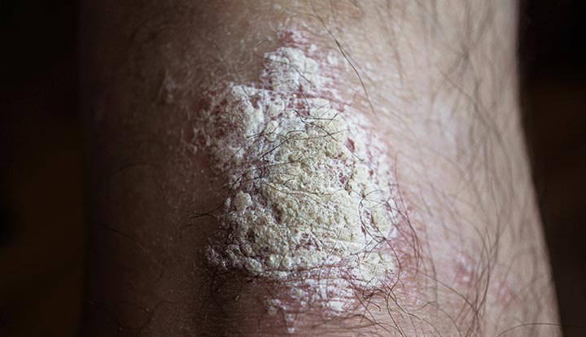

Slide 17
Acne vulgaris
Most common in adolescent males.
Caused by increased testosterone after puberty.
Sebaceous glands in hair follicles become blocked → infected → inflamed.
Leads to pustules; severe cases may cause permanent scarring.
Common sites: face, chest, upper back.

Slide 18
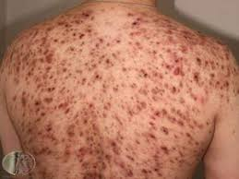
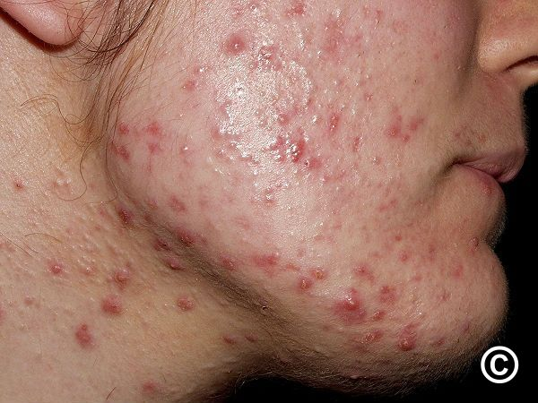
Acne vulgaris

Slide 19
Pressure Ulcers (Decubitus Ulcers / Bedsores)
How They Occur
Form over pressure points where skin is compressed between a bony prominence and a hard surface.
Prolonged pressure → reduced blood flow → ischaemia.
Early stage: redness.
Later: ischaemia + necrosis → skin sloughs → ulcer forms, may enlarge into a cavity.
Infection can lead to septicaemia.
Healing occurs by secondary intention.

Slide 20
Predisposing Factors
Extrinsic factors:
Pressure
Shearing forces
Trauma
Immobility
Moisture
Infection

Slide 21
Intrinsic factors
Poor nutrition
Emaciation
Incontinence
Infection
Concurrent illness
Sensory impairment
Poor circulation

Slide 22
Burns
Causes
Heat, cold, electricity
Ionising radiation
Corrosive chemicals (strong acids or alkalis)
Cause local skin damage affecting structure and function.

Slide 23
Classification of Burns
First Degree
Affects only the epidermis.
Surface is moist, red, swollen, painful.
No blisters; minimal tissue damage.
Second Degree
Affects epidermis + upper dermis.
Symptoms of first degree plus blistering.

Slide 24
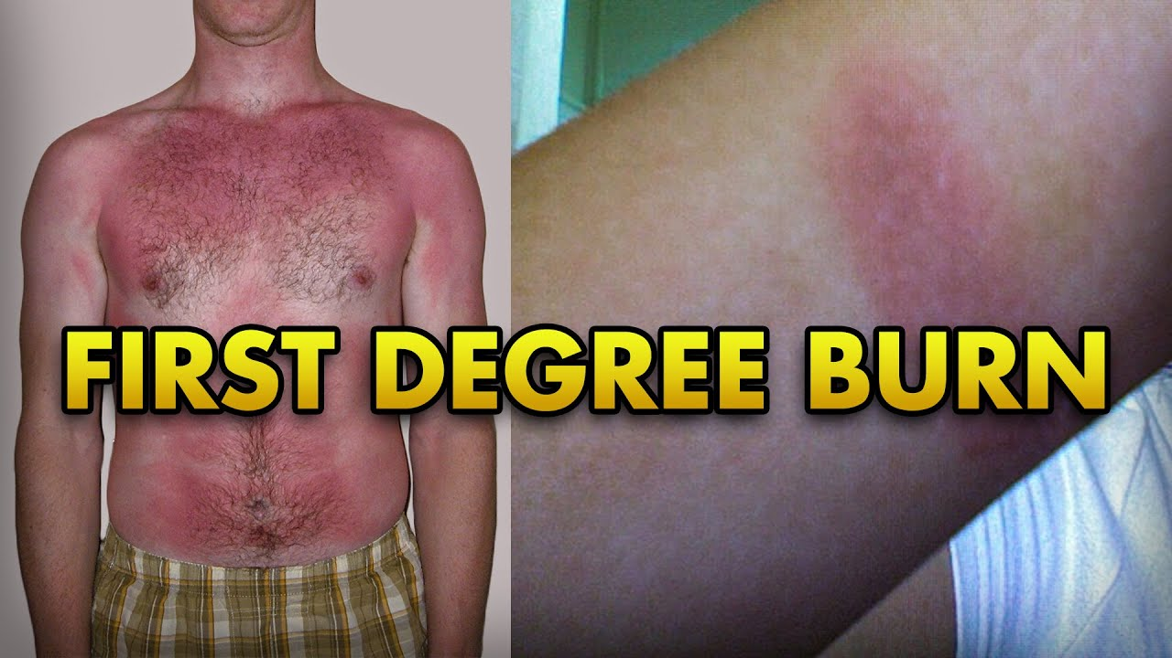
1st degree Burns

Slide 25
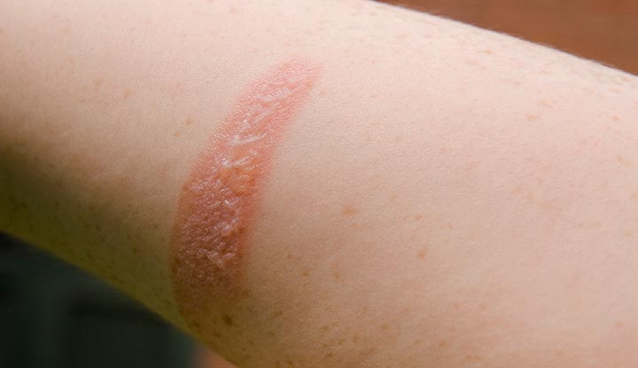
2nd degree Burns

Slide 26
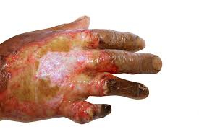
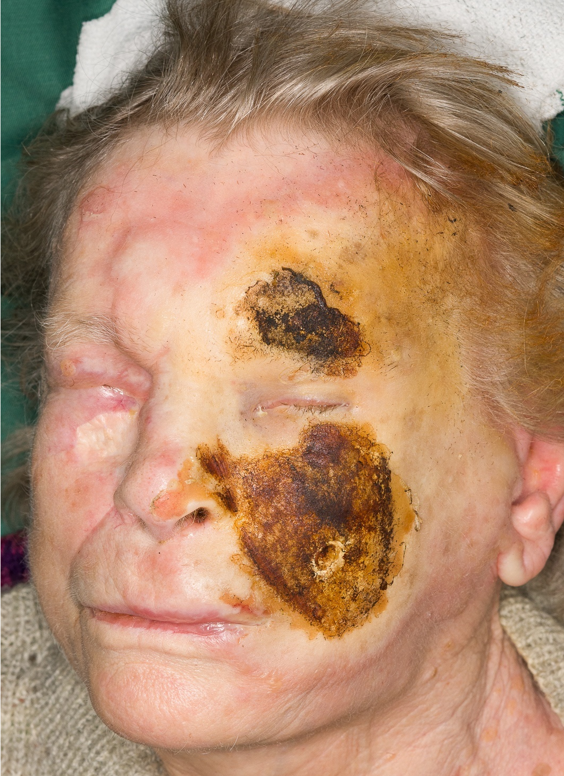
3rd Degree Burns

Slide 27
Third Degree (Full Thickness)
Epidermis and dermis destroyed.
Usually painless (nerve endings destroyed).Forms an eschar (thick scab) that sloughs off after 2–3 weeks.
Circumferential burns can cause:
  Chest burns → respiratory restriction
  Limb burns → circulation impairment
Skin grafting needed (except small burns).Healing is slow, by secondary intention.
No regeneration of sweat glands, hair follicles, sebaceous glands.Scar tissue may restrict movement around joints.

Slide 28
Extent of Burns
Estimated using the Rule of Nines.
Hypovolaemic shock usually occurs if 15% or more of body surface is burned.
High fatality risk in third-degree burns if:
% of surface burned + patient age > 80.

Slide 29
Complications of Burns
Dehydration & Hypovolaemia
Due to excessive loss of water and plasma proteins.
Shock
From severe hypovolaemia.
Hypothermia
Due to heat loss from burn surfaces.

Slide 30
Complications of Burns
Infection
Occurs easily when subcutaneous tissue is exposed. Can lead to septicaemia.
Renal Failure
Happens when kidney tubules cannot process the large amount of waste from haemolysed RBCs and damaged tissues.
Contractures
Develop later due to fibrous scar tissue contracting.
Can distort joints and limit movement (e.g., hands).

Slide 31
Malignant Tumours
1. Basal Cell Carcinoma
Most common and least malignant skin cancer.
Linked to long-term sunlight exposure.
Usually occurs on sun-exposed areas: head, neck.
Starts as a shiny nodule, later breaks down into an ulcer with irregular edges (“rodent ulcer”).
Locally invasive, but rarely metastasises.

Slide 32
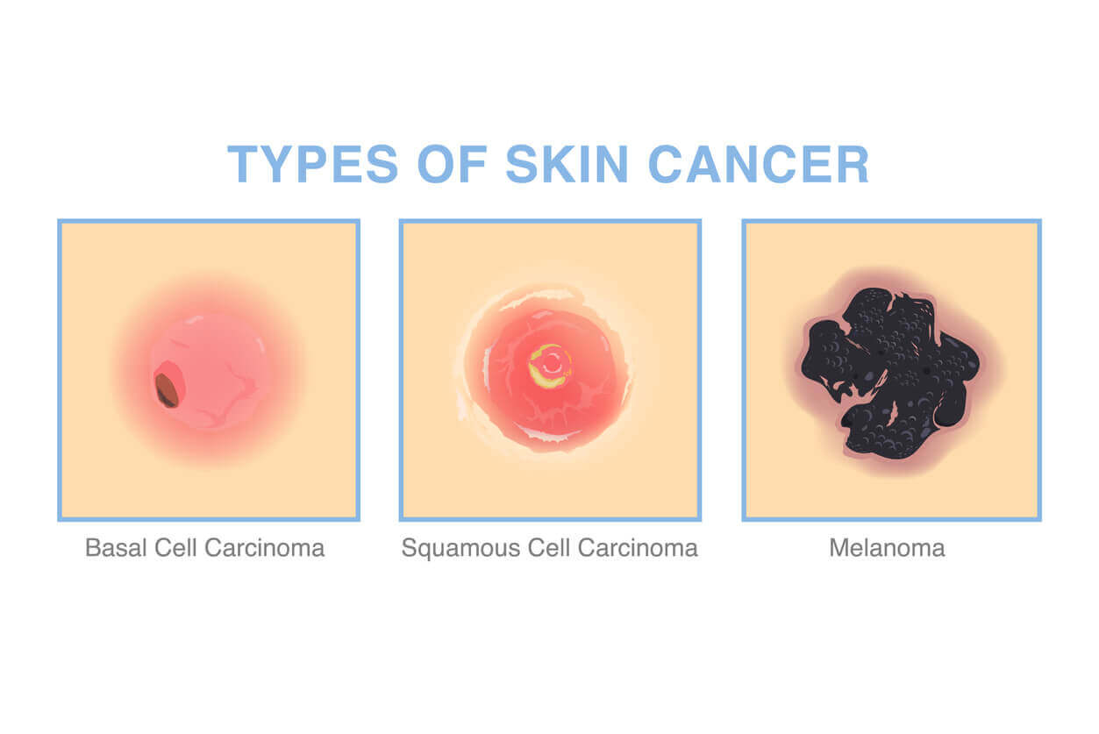
Malignant Melanoma

Slide 33
Malignant Melanoma
Malignant proliferation of melanocytes.
Often begins in a mole that enlarges with irregular borders.
May ulcerate and bleed.
Common in young and middle-aged adults.
Predisposing Factors
Fair skin. Intense, repeated sun exposure and sunburn → especially in childhood.
Gender-Based Common Sites
Females: lower leg
Males: upper back

Slide 34
Malignant Melanoma
Spread & Prognosis
Early metastasis → poor prognosis.
Initially spreads to nearby lymph nodes.
Later spreads via blood to liver, brain, lungs, bowel, bone marrow.
Kaposi’s Sarcoma
Often AIDS-related.Malignant tumour arising in walls of lymphatic vessels.Starts as small red–blue patches or nodules, typically on lower limbs.Can also affect mouth, oesophagus, stomach, intestines.Without treatment: lesions enlarge and multiply.

Slide 35
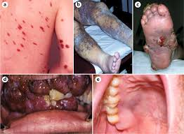
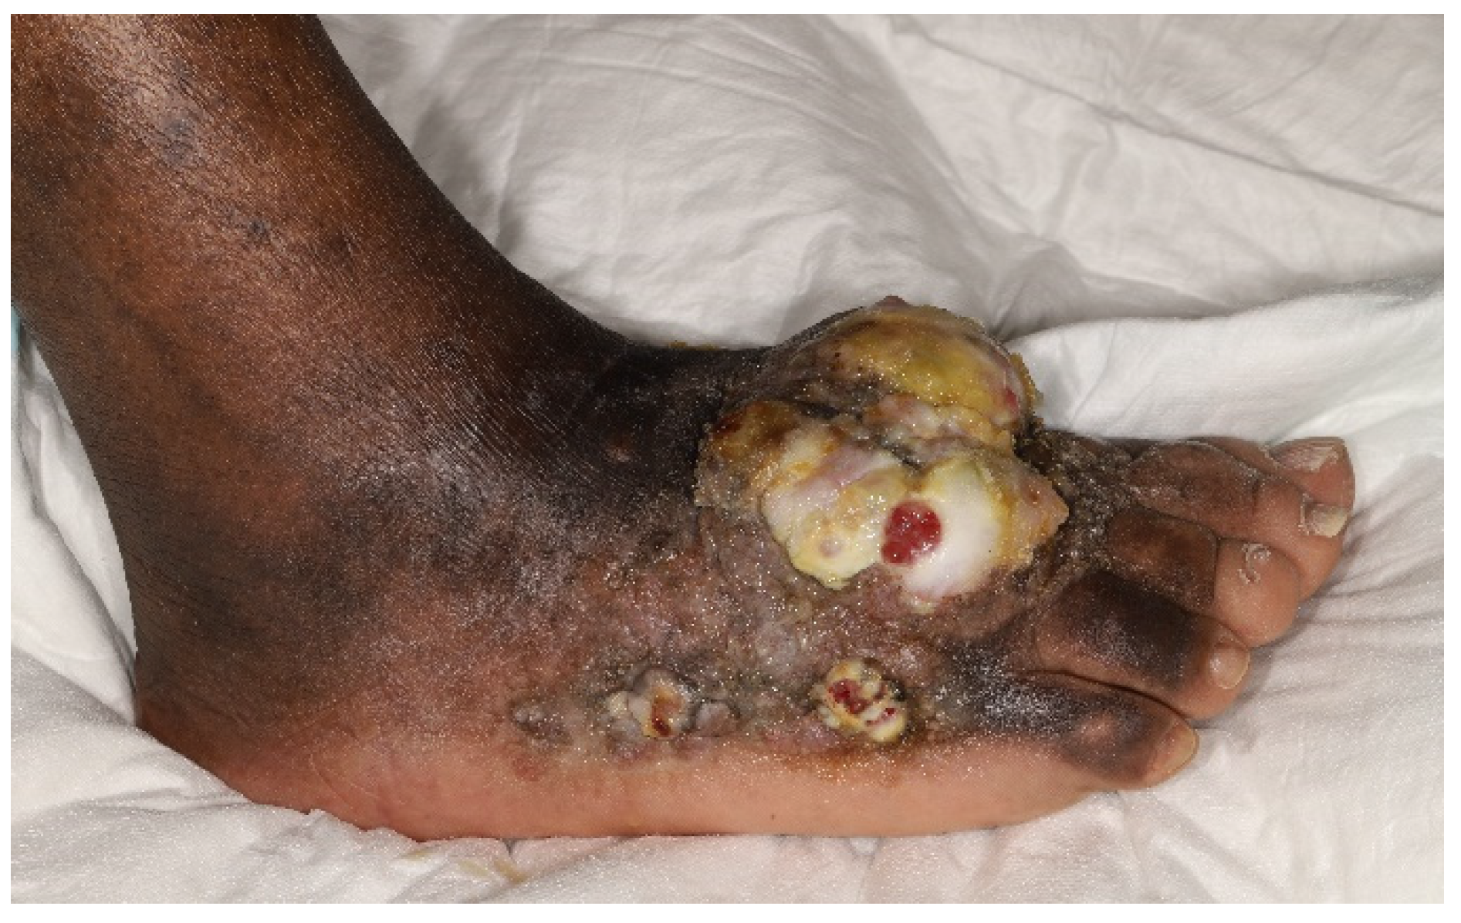
Kaposi’s Sarcoma

