Slide 1

BASIC MEDICAL SCIENCE
FSC MEDICAL TECHNOLOGIES I
DR DANISH

Slide 2
MUSCLES OF BODY
Upper body muscles
Core muscles
Lower body muscles

Slide 3
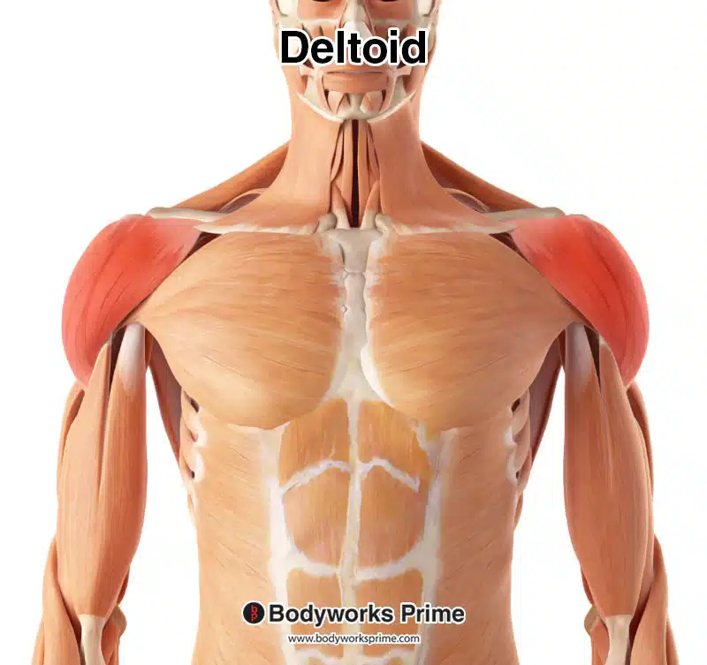
Upper body muscles
Deltoids: Located in the shoulders, help in arm abduction, flexion, and rotation.

Slide 4
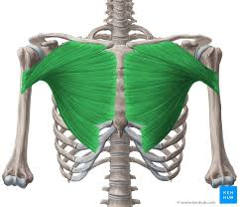
Pectoralis Major:
Situated in the chest, aids in arm adduction, flexion, and internal rotation.

Slide 5
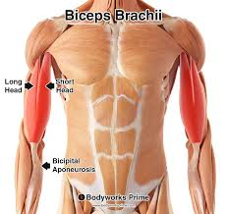
Biceps Brachii
Found in the upper arm, flexes the elbow and supinates the forearm.

Slide 6
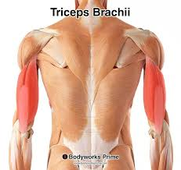
Triceps Brachii
Located in the back of the upper arm, extends the elbow.

Slide 7
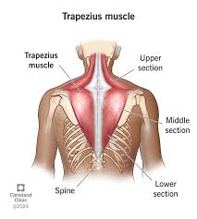
Trapezius
In the neck and upper back, moves and stabilizes the scapulae.

Slide 8
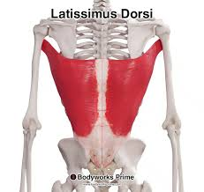
Latissimus Dorsi
In the lower back, extends, adducts, and internally rotates the shoulder.

Slide 9
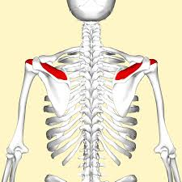
Rotator Cuff Muscles
Supraspinatus: Helps in shoulder abduction.

Slide 10
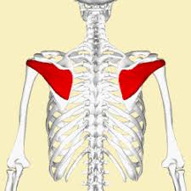
Infraspinatus
Aids in external rotation.

Slide 11
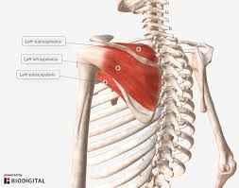
Subscapularis
Helps in internal rotation.

Slide 12
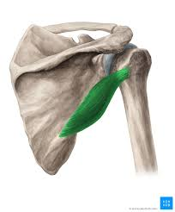
Teres minor
Assists in external rotation

Slide 13
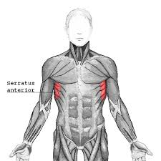
Serratus Anterior
Located on the side of the chest, helps in scapular protraction and upward rotation.

Slide 14
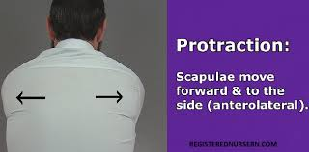
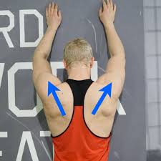

Slide 15


Slide 16


