Slide 1

PHYSIOTHERAPY
TECNIQUES
FSC PT-I
DR DANISH

Slide 2
Stroke
Overview:
Definition: Sudden interruption of blood flow to the brain.
Result: Brain cells are deprived of oxygen and nutrients → cell death.
Emergency: Requires immediate medical attention.

Slide 3
Causes of Stroke
Blockage or rupture of a blood vessel in the brain.
Risk factors: Hypertension, diabetes, smoking, high cholesterol, obesity, age.

Slide 4
Types
1. Ischemic Stroke (≈ 85% of cases)
2. Hemorrhagic Stroke (≈ 15% of cases)
3.Transient Ischemic Attack (TIA)

Slide 5
Ischemic Stroke
Cause: Blood clot or plaque blocks a brain artery.
Subtypes:
  Thrombotic: Clot forms in a brain vessel.
  Embolic: Clot travels from another part of the body (e.g., heart).

Slide 6
Hemorrhagic Stroke
Cause: Rupture of a weak blood vessel → bleeding in or around the brain.
Subtypes:
  Intracerebral hemorrhage: Bleeding within brain tissue.
  Subarachnoid hemorrhage: Bleeding in the space around the brain.

Slide 7
Transient Ischemic Attack (TIA)
"Mini-stroke" – temporary blockage of blood flow.
Symptoms resolve within minutes to hours, but it’s a warning sign for future stroke.

Slide 8
Common Symptoms
Sudden numbness or weakness (face, arm, leg – especially one side).
Trouble speaking or understanding speech.
Vision problems.
Loss of balance, dizziness.
Severe headache with no known cause.

Slide 9
Prevention
Control blood pressure & diabetes.
Quit smoking.
Eat a balanced diet & exercise regularly.
Take prescribed medications (e.g., antiplatelets, anticoagulants if needed).

Slide 10
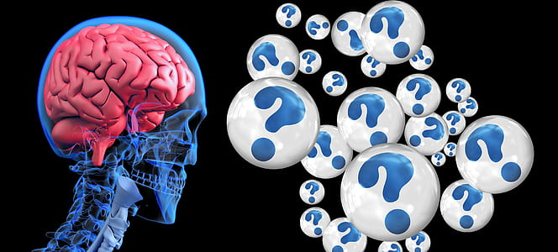

Slide 11


