Slide 1

ANATOMY
BS RIT,OTT,MLT
1ST SEMESTER
DR DANISH

Slide 2
Non-articular surfaces
Non-articular surfaces = all bone areas not involved in forming joints
Do not bear articular cartilage
Serve as attachments and passageways for soft tissues

Slide 3
Process
A process is a projection or outgrowth from a bone.
Found on non-articular surfaces.
Serves as a site for muscle or ligament attachment, or forms part of a joint.

Slide 4
Examples of Bone Processes
Skull:styloid process,mastoid process of bone.
Scapula: Acromion & coracoid processes.
Radius: Styloid process

Slide 5
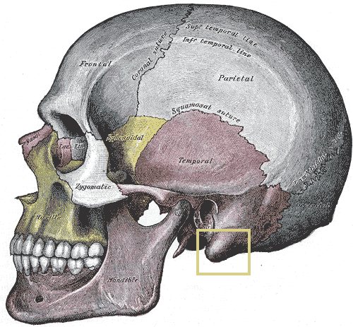

Slide 6
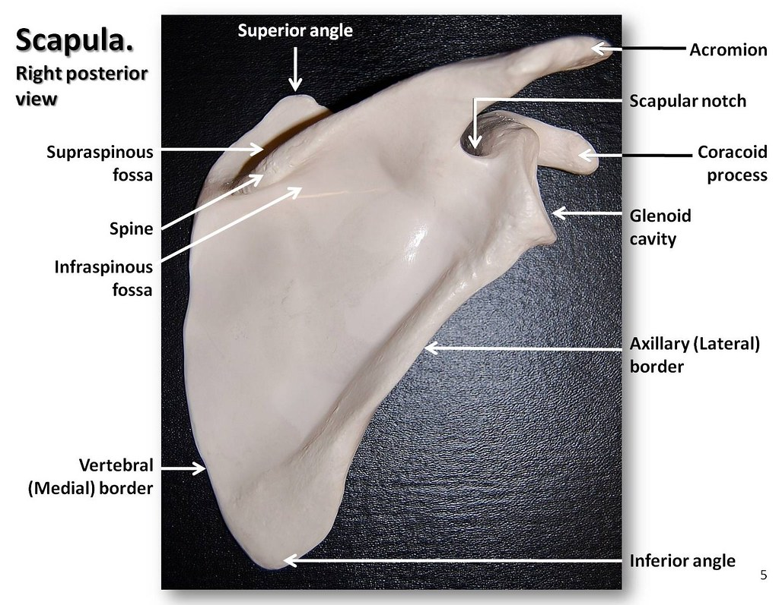

Slide 7
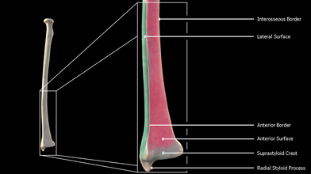

Slide 8
Trochanters
Large, rough projections found only on the femur.
Provide attachment to powerful hip and thigh muscles.
Two main types:
  Greater trochanter – large lateral projection.
  Lesser trochanter – smaller posteromedial projection.

Slide 9
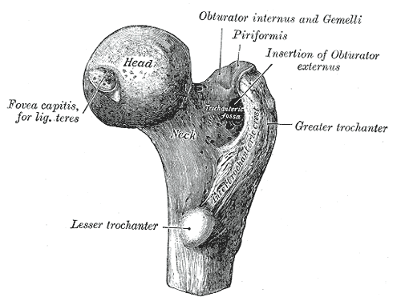

Slide 10
Tubercles
Small, rounded bony elevations on many bones.
Found on long bones, scapula, and ribs.
Serve as attachment points for muscles and ligaments.
Size and roughness vary with muscle strength.

Slide 11
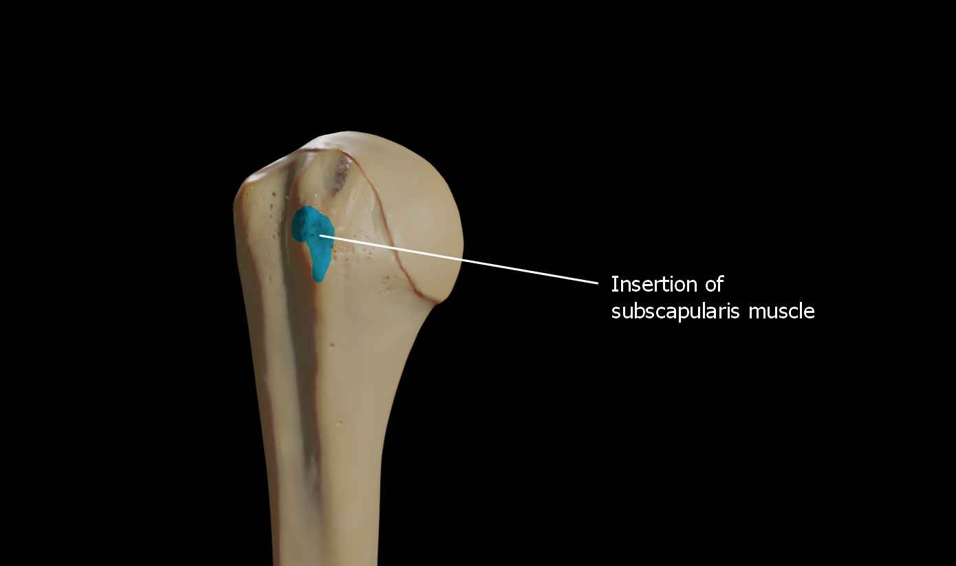

Slide 12
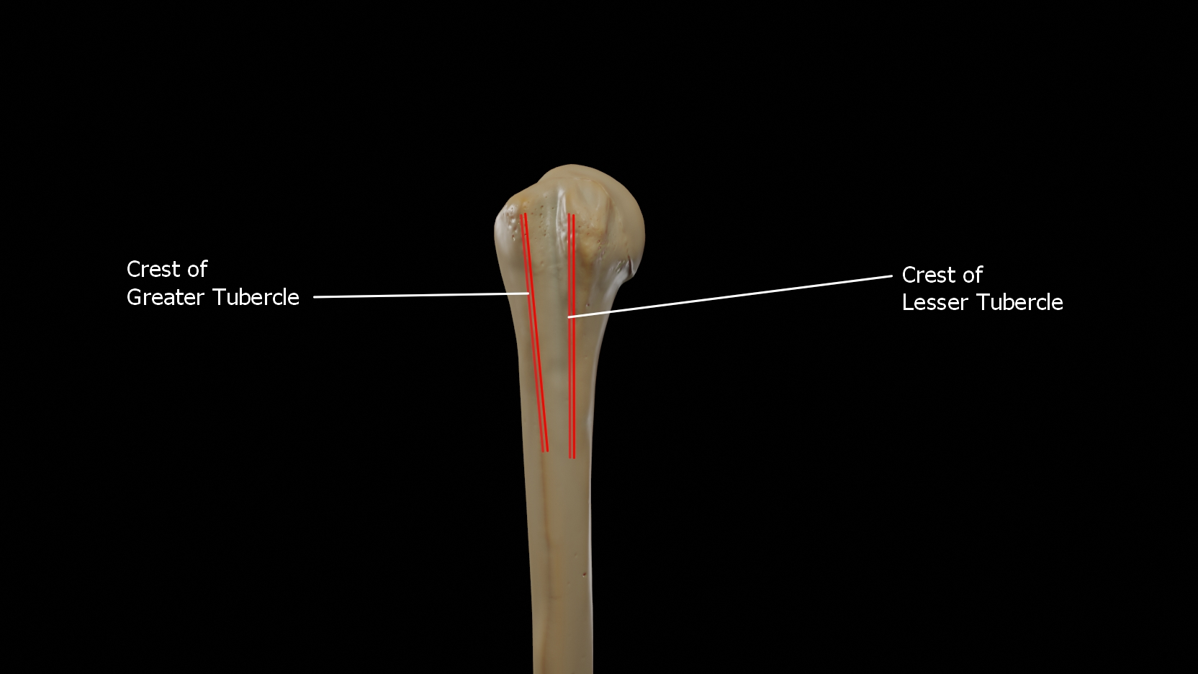
Example:greater and lesser tubercle

Slide 13
Tuberosity
A large, rounded elevation on a bone.
Usually roughened due to strong tendon or ligament attachment

Slide 14
Example
Deltoid Tuberosity (Humerus):
Attachment of deltoid muscle.
Gluteus tuberosity (femur):
Attachement of gluteus maximus muscle.

Slide 15
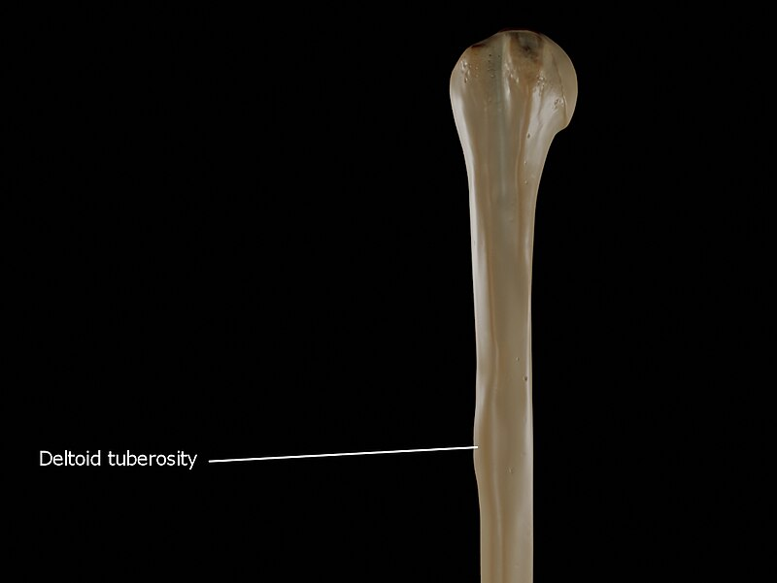
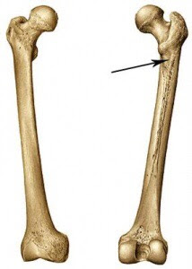

Slide 16
Malleolus
A prominent hammerhead-like projection found on each side of the ankle joint.
Part of tibia and fibula, forming ankle prominences.

Slide 17
Types and Examples of Malleoli
Medial Malleolus:
  On the tibia; forms inner ankle prominence.
  Gives attachment to ligaments of the ankle joint.
Lateral Malleolus:
  On the fibula; forms outer ankle prominence.
  Gives attachment to ligaments of the ankle joint.

Slide 18
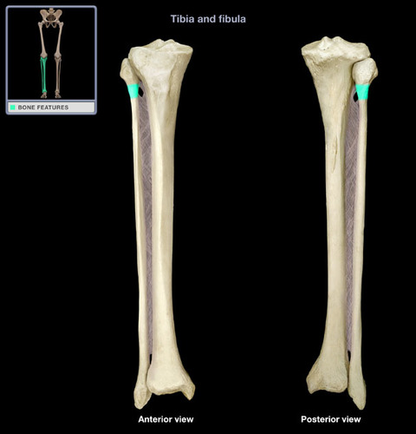

Slide 19


Slide 20


