Slide 1

ANATOMY
BS RIT,OTT,MLT
1ST SEMESTER
DR DANISH

Slide 2
Markings on Bones
Bones have surface features (“markings”)
That reflect where they articulate with other bones (joints), attach muscles/ligaments, or allow passage of vessels/nerves.

Slide 3
Continued
Articular surfaces
Non articular surfaces
Grooves & holes

Slide 4
Articular surfaces
An articular surface is a smooth part of a bone that contacts another bone, forming a joint.

Slide 5
Head
Definition: Rounded, smooth, articular surface on a narrow neck.
Function: Forms part of a joint; covered with articular cartilage.
Examples:
  Head of femur → fits in acetabulum.
  Head of humerus → articulates with glenoid cavity of scapula.

Slide 6
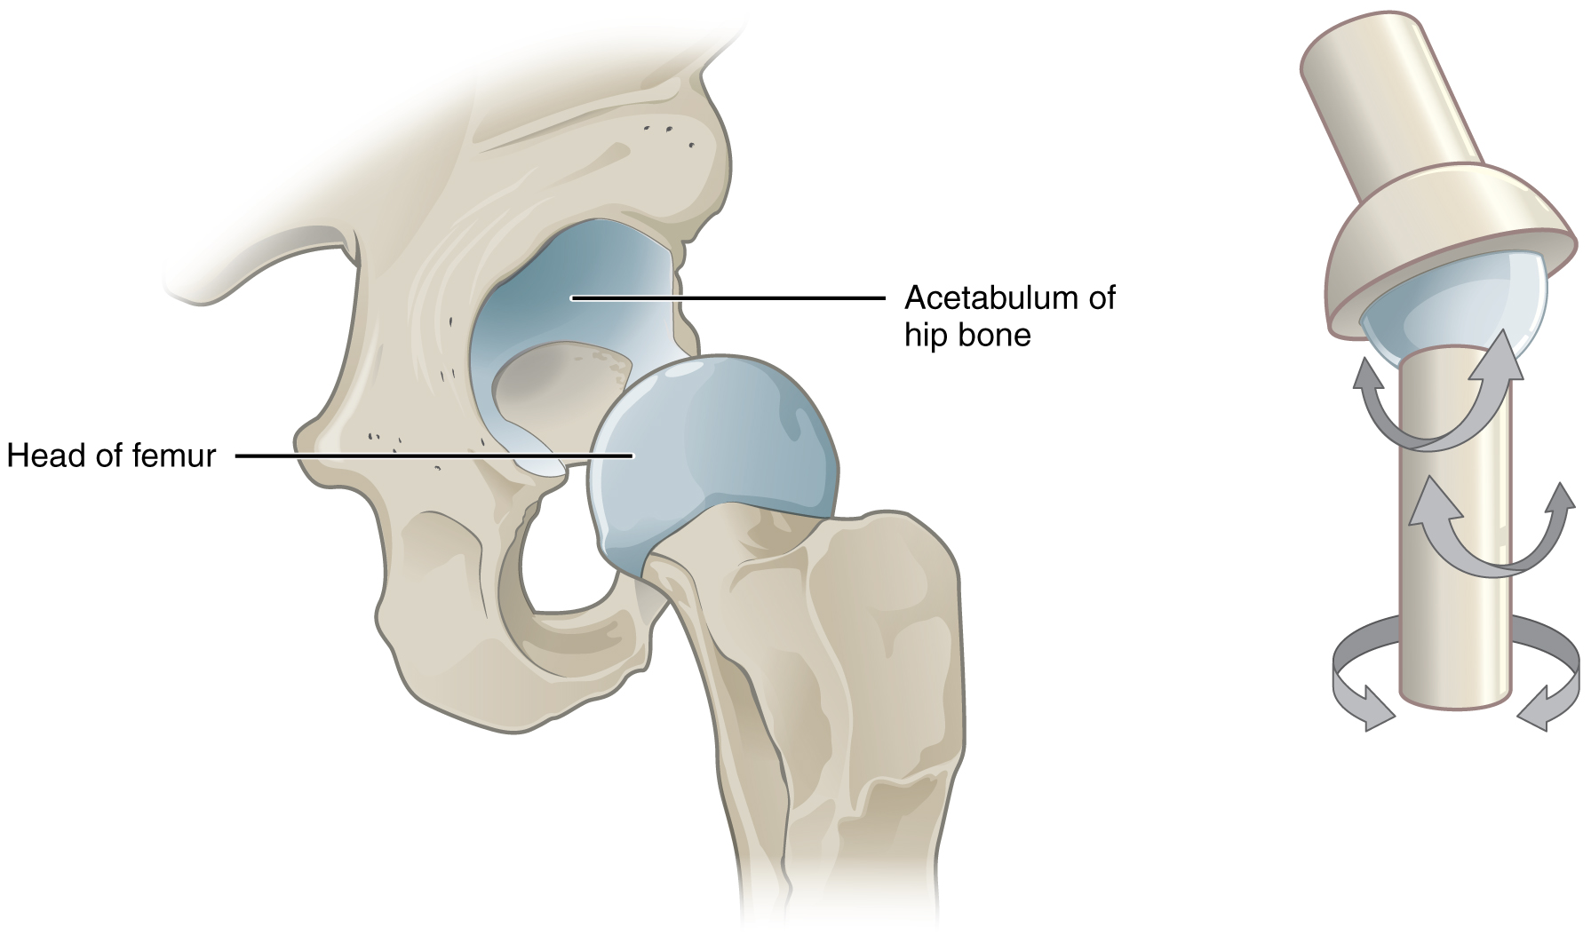

Slide 7
Capitulum
Definition: A small, rounded articular eminence on the lower end of humerus.
Function: Articulates with the head of the radius.
Mnemonic: “Capitulum → Cap on Radius.”
Example: Capitulum of humerus (lateral side).

Slide 8
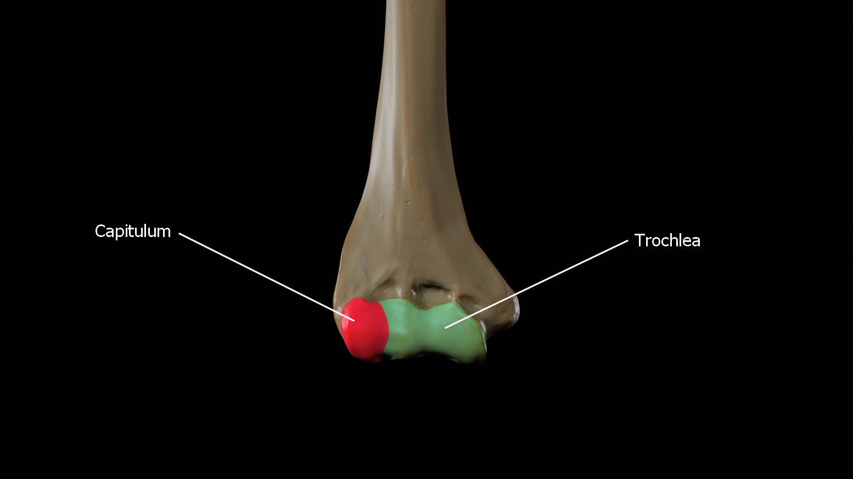

Slide 9
Trochlea
Definition: Pulley-shaped articular surface.
Function: Articulates with the trochlear notch of ulna.
Example: Trochlea of humerus (medial side).
Feature: Allows hinge-like flexion and extension at the elbow.

Slide 10
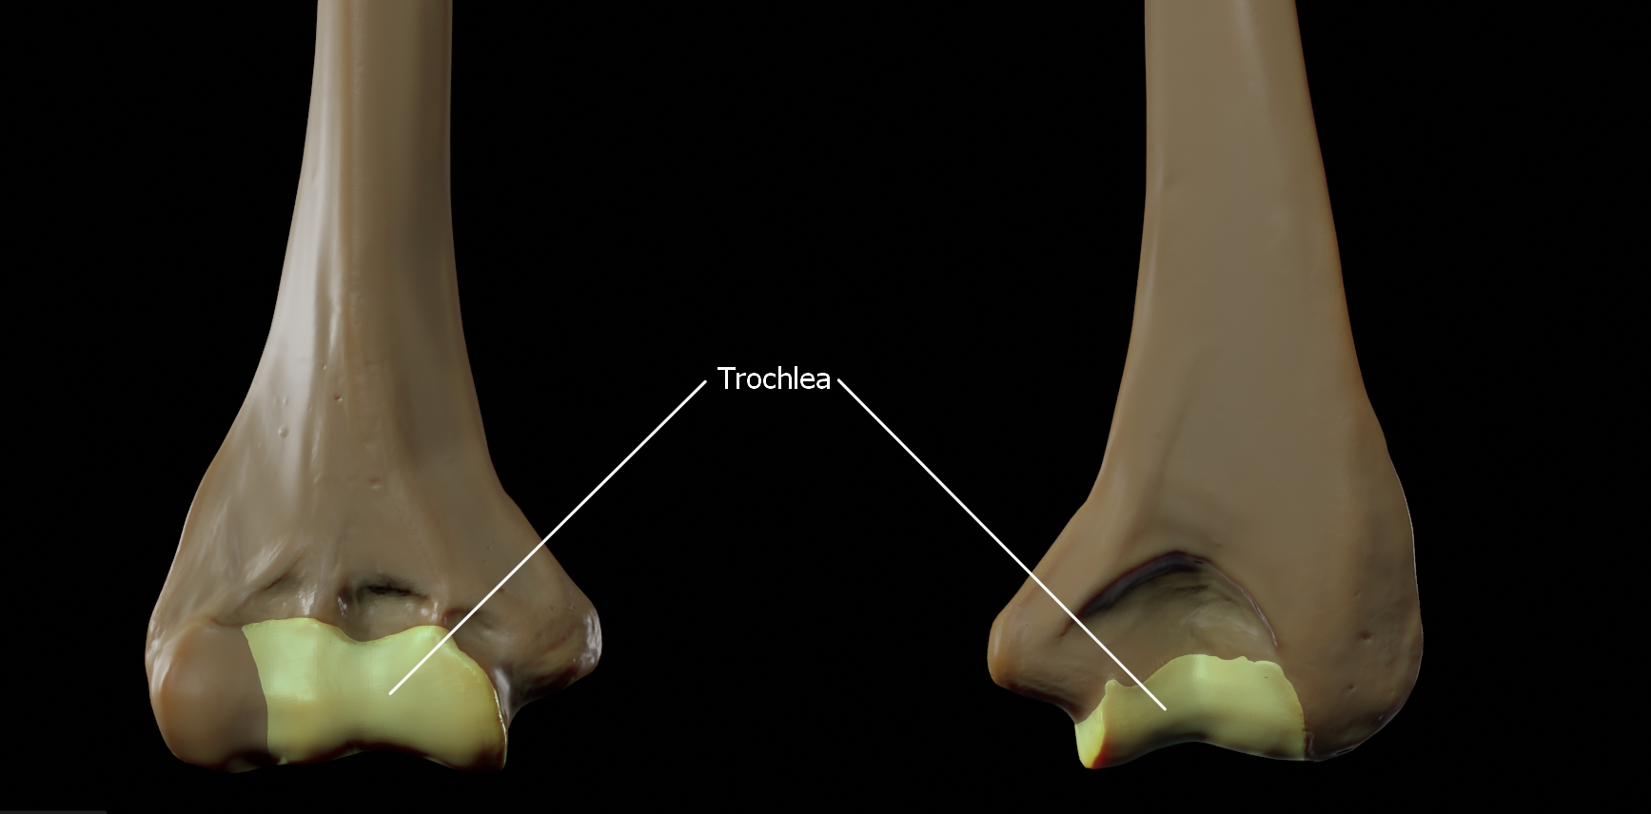

Slide 11
Condyle
Definition: Large, rounded prominence forming part of a joint.
Function: Provides smooth articulation with adjacent bone.
Examples:
  Femoral condyles (with tibia).

Slide 12
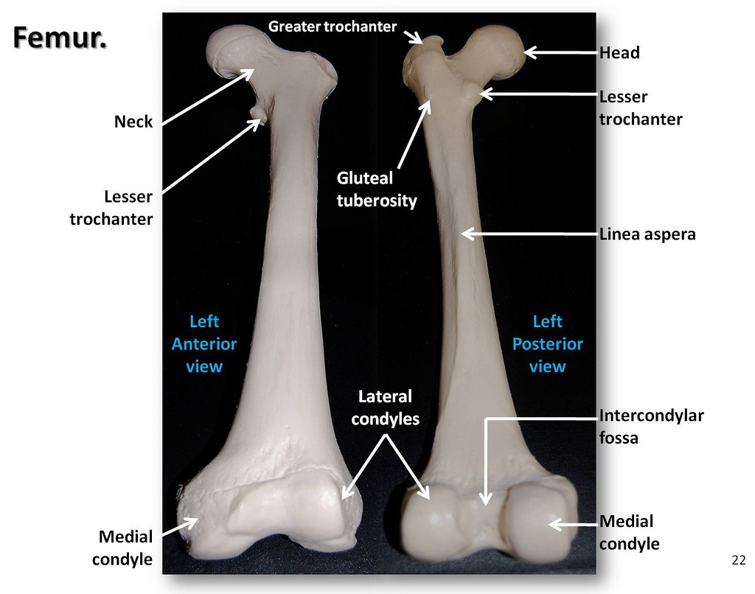

Slide 13
Facet
Definition: Flat or slightly curved articular surface.
Function: Allows gliding motion between bones.
Examples:
  Superior & inferior articular facets of vertebrae.

Slide 14
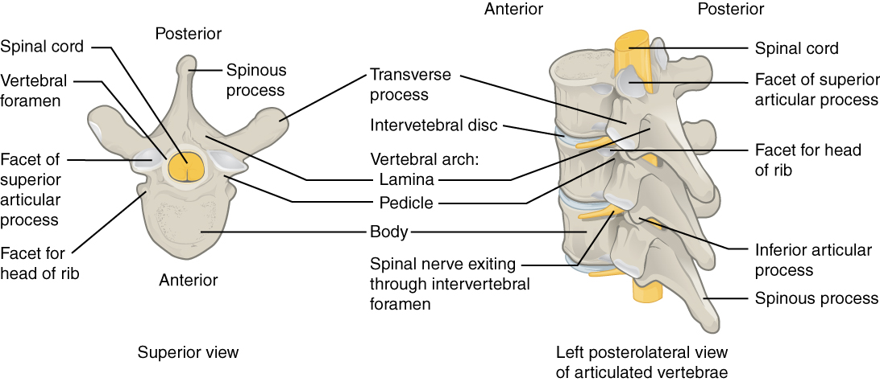

Slide 15
Fossa
Definition: Shallow depression on a bone surface.
Function: May form part of a joint or serve for muscle attachment.
Examples:
  Olecranon fossa (posterior humerus).

Slide 16
Summary
Term | Type | Shape | Function | Example
Head | Articular | Rounded | Joint formation | Head of femur
Capitulum | Articular | Small, round | Articulates with radius | Humerus
Trochlea | Articular | Pulley-shaped | Hinge motion | Humerus
Condyle | Articular | Large, round | Smooth joint | Femur
Facet | Articular | Flat | Gliding | Vertebrae
Fossa | Non-articular | Depression | Joint or muscle attachment | Olecranon fossa

Slide 17


Slide 18


