Slide 1

Social Psychology
Hafsa Rasheed

Slide 2
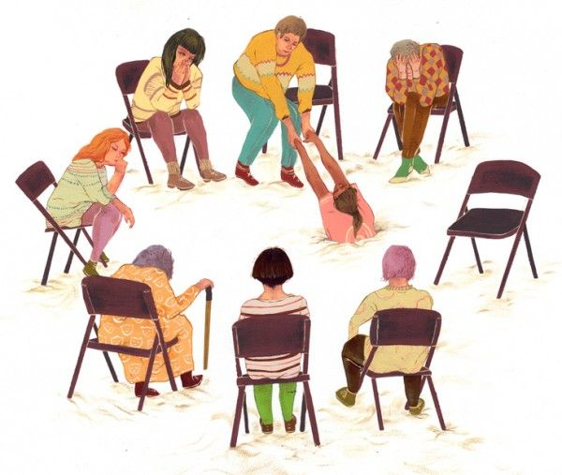
What Do You Think Social Psychology Is?
Why do people behave differently in groups?
Why do we follow trends or opinions of others?
What’s society?
What’s psychology?
Can society impact psychology of a person?

Slide 3
We Use These Words Every Day…
Attitude – Prejudice
Obedience – Pressure
Cooperation – Group Behavior
Influence – Attract
Discrimination – Stereotypes
Empathy – Convince
These words shape our lives — but do we truly understand what they mean and why we act this way?

Slide 4
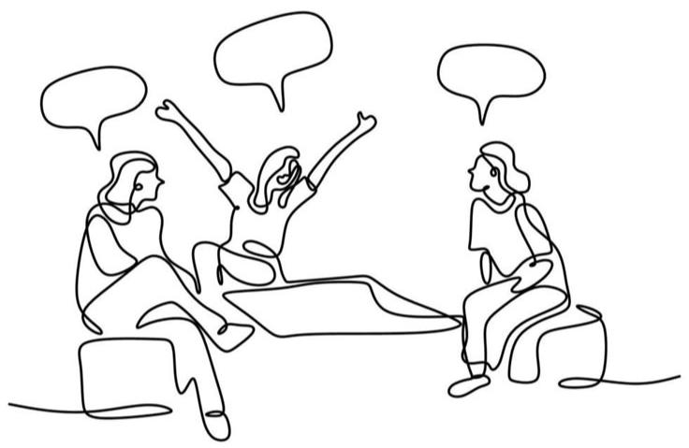
What’s Social Psychology?
Social Psychology is the scientific study of how people think, feel, and behave in social situations.
It simply says, “man is a social animal–his behaviors & thoughts are a product of society”

Slide 5
Continued
Baron, Byrne & Branscombe (2006) – “The scientific study of how people’s thoughts, feelings, and behaviors are influenced by others.”
Gordon Allport (1954) – “The scientific attempt to understand and explain how the thoughts, feelings, and behaviors of individuals are influenced by the actual, imagined, or implied presence of others.”

Slide 6
Why Is Social Psychology Important?
Explains how thoughts, feelings, and behaviors are shaped by others
Enhances self-awareness and understanding of human interaction
Promotes empathy, cooperation, and tolerance in diverse settings
Helps reduce bias, prejudice, and social conflict
Encourages critical thinking about everyday social issue

Slide 7
History of Social Psychology
Late 19th Century: Psychology separates from philosophy — focus on scientific study of behavior
1898 – Norman Triplett: First experiment on social facilitation (performance improves in presence of others)
Early 1900s: Focus expands to attitudes, persuasion, and influence
1940s – Kurt Lewin: Known as Father of Modern Social Psychology; introduced Field Theory — behavior = person × environment

Slide 8
Continued
1950s–1970s: Classic studies —
Solomon Asch’s Conformity Experiment—1951
Stanley Milgram’s Obedience Study—1963
Philip Zimbardo’s Prison Experiment—1971

Slide 9

Any Questions ?

