Slide 1
GENERAL ANATOMY
DPT
1ST SEMESTER
DR DANISH

Slide 2
Accessory Bones
These bones are not always present

Slide 3
Sub Types
Sutural (Wormian) Bones
Supernumerary (True Accessory) Bones
Heterotropic bone

Slide 4
Wormian bone
Found within cranial sutures (especially lambdoid suture).
Formed by extra ossification centers in the skull.
Irregular and small in shape.
Number and size vary between individuals.
Clinical importance: May be mistaken for skull fracture on X-ray.

Slide 5
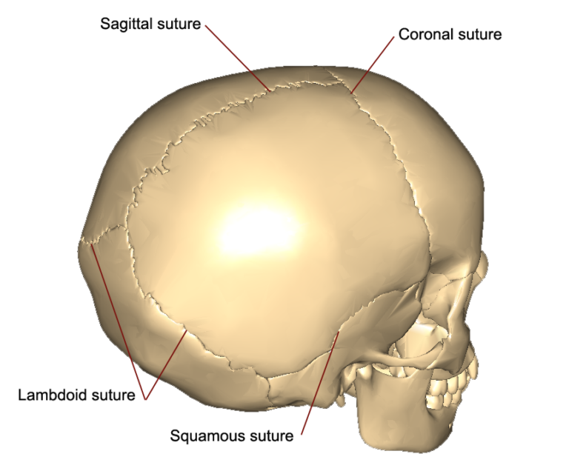

Slide 6
Supernumerary (True Accessory) Bones
Extra bones formed in addition to normal skeleton.
Arise from failure of fusion of ossification centers.
Usually found in hands and feet.

Slide 7
Examples
Os trigonum – posterior to talus.
Os tibiale externum – near navicular bone.
Os centrale carpi – between carpal bones.

Slide 8
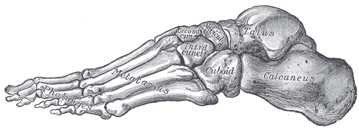

Slide 9
Heterotopic Bones
Definition
Heterotopic bones are bones developed in abnormal locations.
Formed within soft tissues (muscles, tendons, or fascia) where bone is not normally present.
Result of metaplasia of connective tissue into bone.

Slide 10
Causes
Chronic irritation or trauma to soft tissues.
Inflammation or hemorrhage in muscles.
Genetic disorders
Post-surgical or post-injury bone formation

Slide 11
Sites / Examples
Riders bone – in adductor muscles of thigh (seen in horse riders).
Hunter’s bone – in deltoid muscle (seen in shooters).

Slide 12


