Slide 1
Overview of Dental Education and Training (BDS)
ADNAN RAMZAN
BS(0TT+RIT)
Doctors Institute of Medical and Emerging Science

Slide 2
Introduction
BDS stands for Bachelor of Dental Surgery.
BDS trains students to become dentists who take care of teeth, mouth, and oral health.

Slide 3
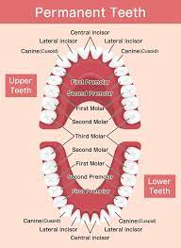
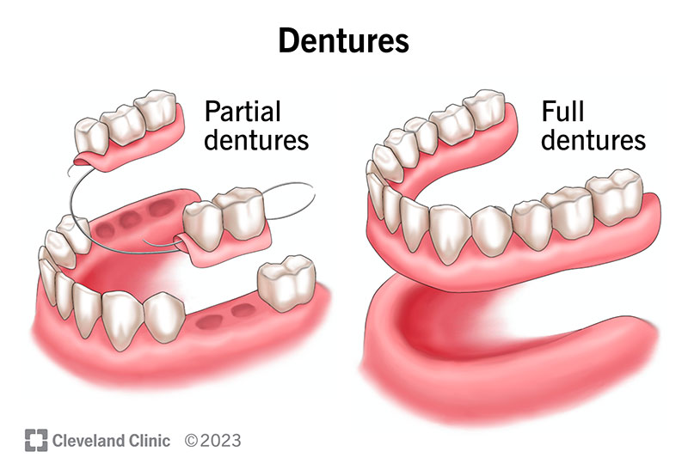

Slide 4
Goals of BDS
Teach how to prevent and treat dental diseases.
Train in performing dental procedures.
Develop skills in patient care and oral health education.

Slide 5
Duration and Structure
The BDS course takes 5 years.
4 years of study
1 year of internship.

Slide 6
Admission
12th-grade science (Biology)
Entrance exams (like NEET)
Good practical and manual skills.

Slide 7
Basic Science Subjects
In the first years, students study:
Anatomy
Physiology
Biochemistry
Dental materials
Oral histology.

Slide 8
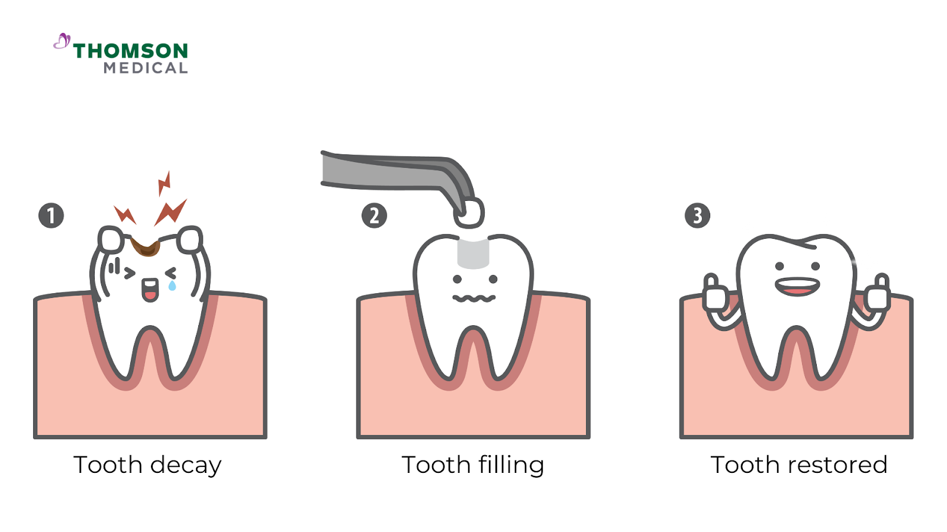
Preclinical Dental Training
Before treating real patients, students practice on:
Mannequins or dummy teeth
Learn to make fillings, impressions, and dentures.

Slide 9
Clinical Training
Later, students work in dental clinics and treat real patients under supervision.
They rotate in:
Oral Surgery
Orthodontics (braces)
Periodontics (gum care)
Prosthodontics (dentures, crowns).
Notes:
firm, pink tissue in your mouth that anchors your teeth. Periodontics (gum
Dentures are custom-made, removable replacements for missing teeth and surrounding tissues, made from materials like acrylic and porcelain. They come in two main types: complete dentures that replace all teeth in an arch, and partial dentures that replace one or a few missing teeth. Dentures help restore the ability to eat and speak, improve facial structure, and boost self-esteem

Slide 10
Teaching and Exams
Regular theory and practical classes
Case discussions and viva exams
Students must complete clinical work quotas.

Slide 11
Internship
In the final year, students work full-time in dental hospitals to gain real-world experience.

Slide 12
Key Skills Learned
Diagnosing dental problems
Performing treatments safely
Communicating with patients
Following sterilization and infection control.

Slide 13
Use of Technology
Modern dentistry uses:
3D printing
Digital X-rays and scanners
Computer-designed crowns (CAD/CAM).

Slide 14
Challenges
Expensive materials and equipment
Limited patient flow in colleges
Posture-related health issues for dentists.

Slide 15
Career Options After BDS
Private practice (own clinic)
MDS (Master in Dental Surgery)
Teaching in dental colleges
Research or public health dentistry.

Slide 16
Future of Dentistry
AI in dental diagnosis
Laser dentistry
Cosmetic and digital smile design
Tele-dentistry.

Slide 17
MBBS vs BDS (Comparison)
Feature MBBS, BDS
Duration 5–6 yrs , 5 yrs
Focus Whole body Teeth & oral health
Internship 1 year 1 year
Career Doctor Dentist.

Slide 18
Conclusion
Both MBBS and BDS are important for healthcare.
Doctors care for the body, dentists care for oral health — both aim to improve lives.

Slide 19


