Slide 1
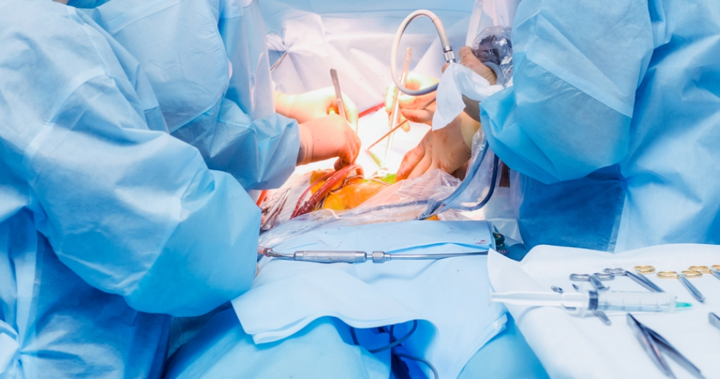
Draping

Slide 2
What is Draping?
Covering patient and surrounding area with sterile sheets before surgery.
Purpose: create and maintain a sterile field.
Prevents movement of microorganisms between sterile and non-sterile areas.
Types: Disposable and Reusable Drapes.

Slide 3
Purpose of Surgical Draping
Maintain asepsis during operation.
Protect patient and surgical team from infection.
Isolate the operative site.
Provide clean working area for surgeon.

Slide 4
Draping Materials
Resistant to blood, fluids, and microorganisms.
Lint-free and static-free.
Maintain isothermal environment (body temperature).
Allow sterilization by steam or gas.

Slide 5
Reusable Drapes
Made from cotton or muslin fabric.
Sterilized and laundered after each use.
May lose quality after ~75 sterilizations.
Regular inspection required for damage or contamination.

Slide 6
Disposable Drapes
Made from synthetic, fluid-resistant materials.
Used once and then incinerated (burned).
Reduce contamination risk, easy to handle.
Need proper disposal to prevent pollution.

Slide 7
Plastic Incisional Drapes
Made from polyvinyl (transparent) material.
Stick directly to skin at incision site.
Used on irregular areas like neck, joints, and ears.
Prevent microorganism migration.

Slide 8
Standard Drapes
Plain sheets used for covering tables, patients, instruments.
Large enough to provide safety margin.
Fenestrated drapes expose only surgical area.
Towels used as small drapes around incision site.

Slide 9
Perineal Drapes
Used for surgeries on perineum and genital areas.
Lithotomy drape has two leg sections.
Used in delivery, cystoscopy, gynecological procedures.

Slide 10
Draping Procedure
Carry folded sterile drape carefully to the operating site.
Unfold gently and position correctly – do not move after placement.
Hold above waist level (below waist = unsterile).
Do not shake or fan drapes; it spreads dust or bacteria.

Slide 11
Drape from sterile to unsterile area.
If a drape touches an unsterile surface, replace it.
Use non-perforating towel clamps to secure drapes or tubing.
Drape incision area first, then cover the periphery.

Slide 12
Folding Drapes for Use
Folded for easy handling and safety.
Large drapes fan-folded bottom to top.
Small sheets folded in half then quartered.
Proper folding helps in quick and sterile draping.

Slide 13
Summary
Draping is vital for asepsis in surgery.
Choose drape based on type of surgery.
Maintain strict sterile technique.
Discard contaminated drapes immediately.
Clean drape = Safe surgery.

Slide 14
Extra Tips
Sterile technique is teamwork.
Drape nearest area first.
Touch drapes only with sterile gloves.
Move slowly to avoid air currents.
Learn to identify different drapes and their uses.

Slide 15


