Slide 1
BASIC MEDICAL SCIENCE
FSC MEDICAL TECHNOLOGIES I
DR DANISH

Slide 2
Joints
Joints are places where two or more bones meet.
They allow movement and provide mechanical support.

Slide 3
Functions of Joints
Enable movement of the body and skeleton
Provide flexibility and stability
Help bear weight and absorb shock

Slide 4
Classification of Joints (by Structure)
Fibrous Joints
Bones joined by dense connective tissue
No movement (immovable)
Examples: Skull sutures, teeth sockets

Slide 5
TYPES OF FIBROUS JOINTS
Sutures:found in skull,fibrous joints that unite bones of skull
syndesmoses:joints connected by ligaments ,allow limited movements
E.g distal tibiofibular joint
Gomphoses:found in attachement of teeth to sockets in jaw

Slide 6
Cartilaginous Joints
Bones connected by cartilage
Slightly movable
Examples: Intervertebral discs, pubic symphysis

Slide 7
Types
Synchondroses:joints joined by hyaline cartilage ,often temporary
seen in the epiphyseal of growing long bones

Slide 8
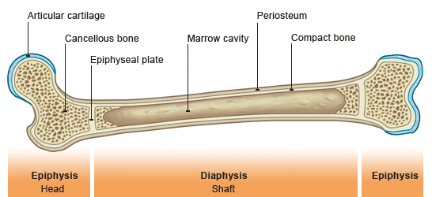

Slide 9
Continued
Symphyses:joints are connected by fibrocartilage,limited movements
example:pubic symphysis in pelvic region

Slide 10
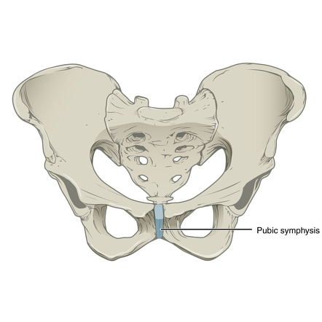

Slide 11


Slide 12


